Slide 1




Short-range correlation physics at low renormalization group (RG) resolution
Anthony Tropiano¹, Scott Bogner², Dick Furnstahl¹
¹Ohio State University, ²Michigan State University
Los Alamos seminar
December 15, 2021
ajt, S.K. Bogner, and R.J. Furnstahl, arXiv:2105.13936
Phys. Rev. C 104, 034311 (2021)

Slide 2
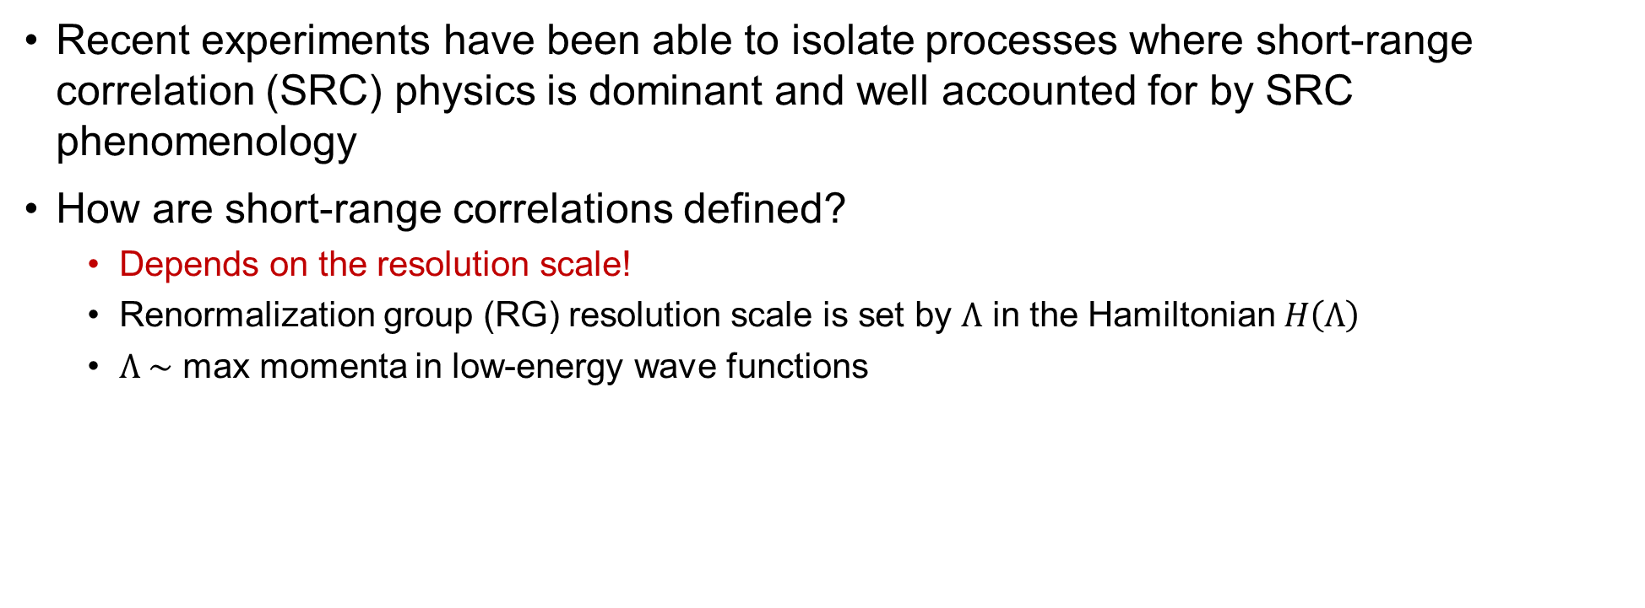
Short-range correlations
Recent experiments have been able to isolate processes where short-range correlation (SRC) physics is dominant and well accounted for by SRC phenomenology
How are short-range correlations defined?
Depends on the resolution scale!
Renormalization group (RG) resolution scale is set by $Λ$ in the Hamiltonian $H\left(Λ\right)$
$Λ \sim$ max momenta in low-energy wave functions
Notes:
Experiments have recently been able to isolate processes where SRC physics is dominant and well described by SRC phenomenology such as the Generalized Contact Formalism (GCF) or Low-order Correlation operator Approximation.
To start, I’ll posit this question here and ask how are SRCs defined?
This technically depends on the resolution scale.
I specifically mean the RG resolution scale which is set by the Hamiltonian by this parameter \Lambda.
\Lambda roughly corresponds to the max momenta in low-energy wave functions of the Hamiltonian.

Slide 3
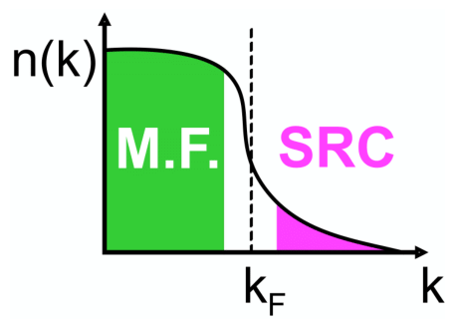
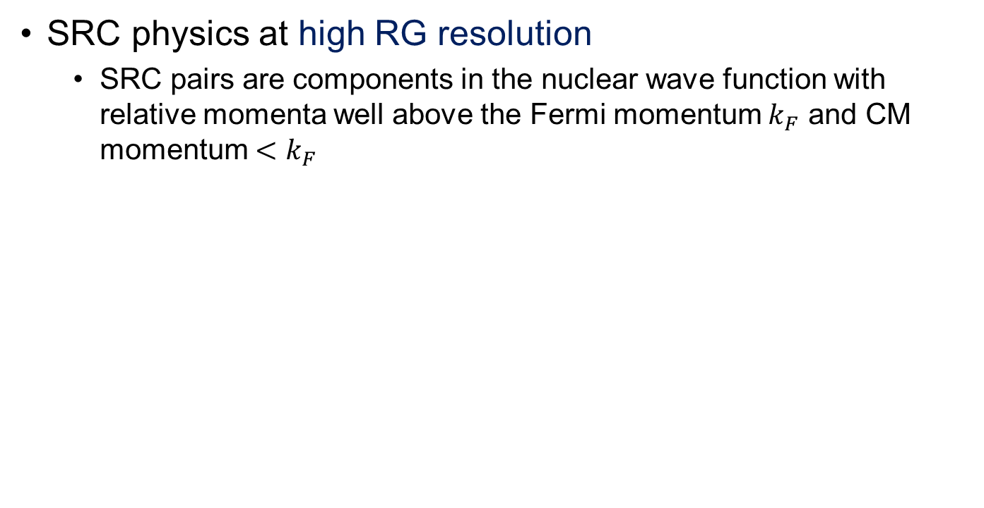
High and low RG resolution
SRC physics at high RG resolution
SRC pairs are components in the nuclear wave function with relative momenta well above the Fermi momentum $k_{F}$ and CM momentum $<k_{F}$
High RG resolution
Notes:
I’ll first compare high and low RG resolutions looking at the nuclear wave function first.
Read bullet.
Talk about cartoon.

Slide 4
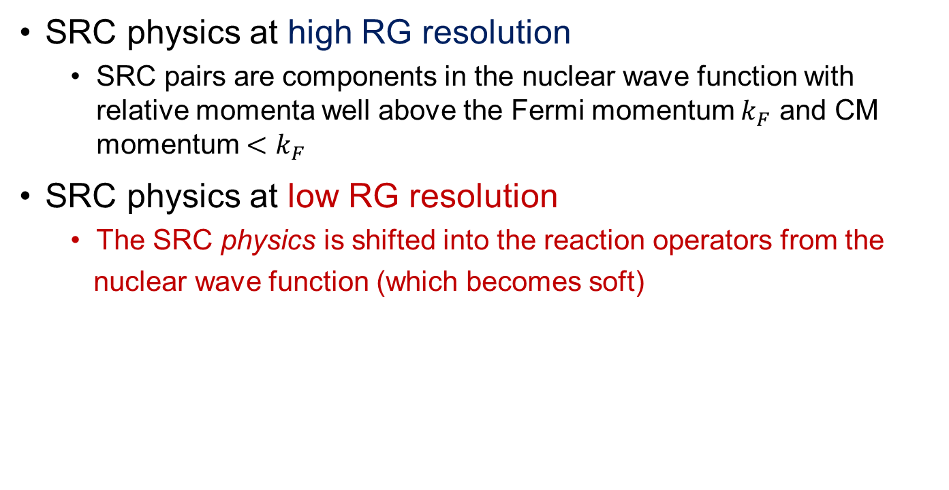
High and low RG resolution
SRC physics at high RG resolution
SRC pairs are components in the nuclear wave function with relative momenta well above the Fermi momentum $k_{F}$ and CM momentum $<k_{F}$
SRC physics at low RG resolution
The SRC physics is shifted into the reaction operators from the
nuclear wave function (which becomes soft)
Low RG resolution
Notes:
Read second bullet.
Talk about cartoon.

Slide 5
High and low RG resolution
knock-out 2 high-k nucleons
High RG resolution: One-body current operators with correlated wave functions
excite SRC pair
same expt. resolution
low-k initial pair
Notes:
Next we’ll compare operators at high and low RG resolution.
Explain figure: This diagram shows electron scattering in the high RG picture, where 2 high momentum nucleons are knocked out after a one-body current operator interacted with an SRC pair in the target nucleus.

Slide 6
High and low RG resolution
knock-out 2 high-k nucleons
High RG resolution: One-body current operators with correlated wave functions
Low RG resolution: Two-body current operators with uncorrelated wave functions
Operators do NOT become hard, which simplifies calculations!
excite SRC pair
same expt. resolution
low-k initial pair
Notes:
At low RG resolution, we still detect two high momentum nucleons knocked out, but here the operator has an induced two-body current and interacts with low momentum nucleons in the nucleus.
The induced 2-body current does not make the operator hard, and with uncorrelated wave functions, this greatly simplifies calculations.

Slide 7
High and low RG resolution
knock-out 2 high-k nucleons
High RG resolution: One-body current operators with correlated wave functions
Low RG resolution: Two-body current operators with uncorrelated wave functions
Operators do NOT become hard, which simplifies calculations!
Experimental resolution (set by momentum of probe) is the same in both pictures
Same observables but different physical interpretation!
excite SRC pair
same expt. resolution
low-k initial pair
Notes:
Read bullets.

Slide 8
High and low RG resolution
knock-out 2 high-k nucleons
High RG resolution: One-body current operators with correlated wave functions
Low RG resolution: Two-body current operators with uncorrelated wave functions
Operators do NOT become hard, which simplifies calculations!
Experimental resolution (set by momentum of probe) is the same in both pictures
Same observables but different physical interpretation!
This talk:
How can SRC calculations be carried out at low RG resolution?
What can we describe with simple approximations?
Connections to existing SRC phenomenology (e.g., GCF/LCA)
excite SRC pair
same expt. resolution
low-k initial pair
Notes:
In this talk, I’ll explain how (step through each).

Slide 9
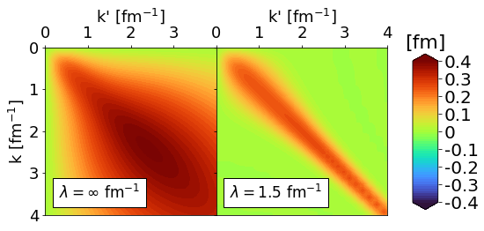
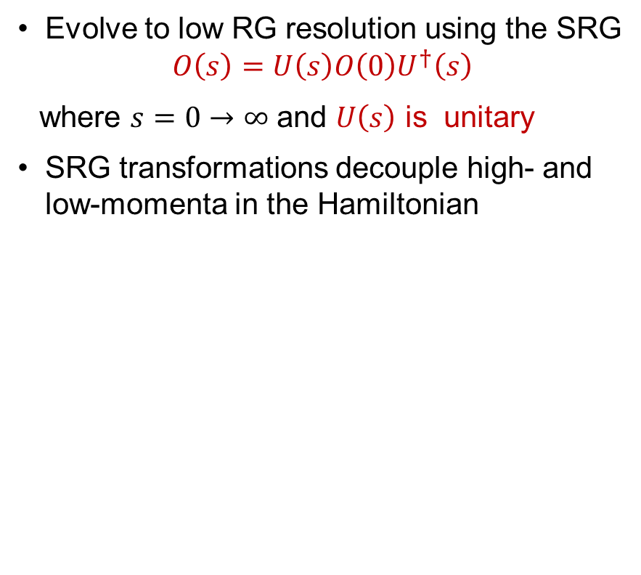
Similarity renormalization group
Evolve to low RG resolution using the SRG
$$O\left(s\right)=U\left(s\right)O\left(0\right)U^{†}\left(s\right)$$
where $s=0→∞$ and $U\left(s\right)$ is unitary
SRG transformations decouple high- and low-momenta in the Hamiltonian
Fig. 1: Momentum space matrix elements of Argonne v18 (AV18) under SRG evolution in ¹P₁ channel.
Notes:
To transform to low RG resolution, we use the Similarity Renormalization Group (or SRG), which involves applying unitary transformations to operators.
The way this works is the SRG transformations decouple the high and low momentum scales of the Hamiltonian where s=0 corresponds to the initial Hamiltonian…
Explain figure

Slide 10
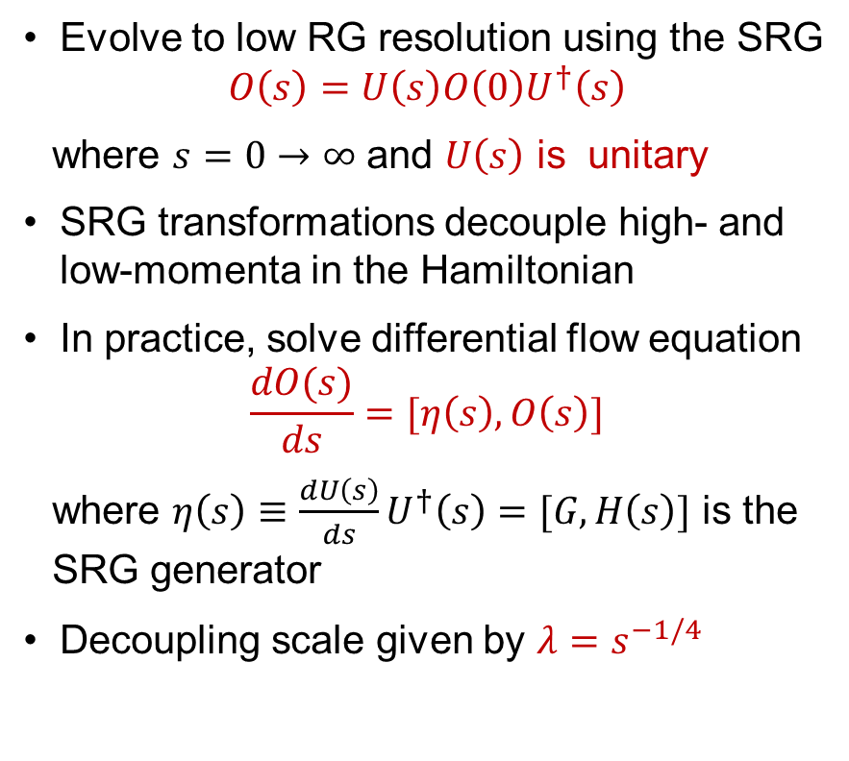
Similarity renormalization group
Evolve to low RG resolution using the SRG
$$O\left(s\right)=U\left(s\right)O\left(0\right)U^{†}\left(s\right)$$
where $s=0→∞$ and $U\left(s\right)$ is unitary
SRG transformations decouple high- and low-momenta in the Hamiltonian
In practice, solve differential flow equation
$$\frac{dO(s)}{ds}=[η\left(s\right),O\left(s\right)]$$
where $η\left(s\right)≡\frac{dU\left(s\right)}{ds}U^{†}\left(s\right)=[G,H\left(s\right)]$ is the SRG generator
Decoupling scale given by $λ=s^{−1/4}$
Fig. 1: Momentum space matrix elements of Argonne v18 (AV18) under SRG evolution in ¹P₁ channel.
Notes:
Read next two bullets mentioning units of \lambda and roughly the width of the band diagonal.

Slide 11
Similarity renormalization group
SRC in AV18
AV18 wave function has significant SRC
What happens to the wave function under SRG transformation?
S-state
D-state
Fig. 2: SRG evolution of deuteron wave function in coordinate space for AV18 and Gezerlis N²LO¹.
¹A. Gezerlis et al., Phys. Rev. C 90, 054323 (2014)
Notes:
Next we will look at how wave functions transform under SRG transformations using the deuteron as an example.
Explain figure (y-axis, red/black, solid/dashed, SRC).
Read last bullet.

Slide 12
Similarity renormalization group
SRC in AV18
No SRC
SRC physics in AV18 is gone from wave function at low RG resolution
Deuteron wave functions become soft and D-state probability goes down
Observables such as asymptotic D-S ratio are the same
SRG evolved
S-state
S-state
D-state
D-state
Fig. 2: SRG evolution of deuteron wave function in coordinate space for AV18 and Gezerlis N²LO¹.
¹A. Gezerlis et al., Phys. Rev. C 90, 054323 (2014)
Notes:
At low RG resolution, SRC physics in AV18 wave function is gone, both curves collapse on one another, D-state probability is suppressed, but observables are the same.

Slide 13
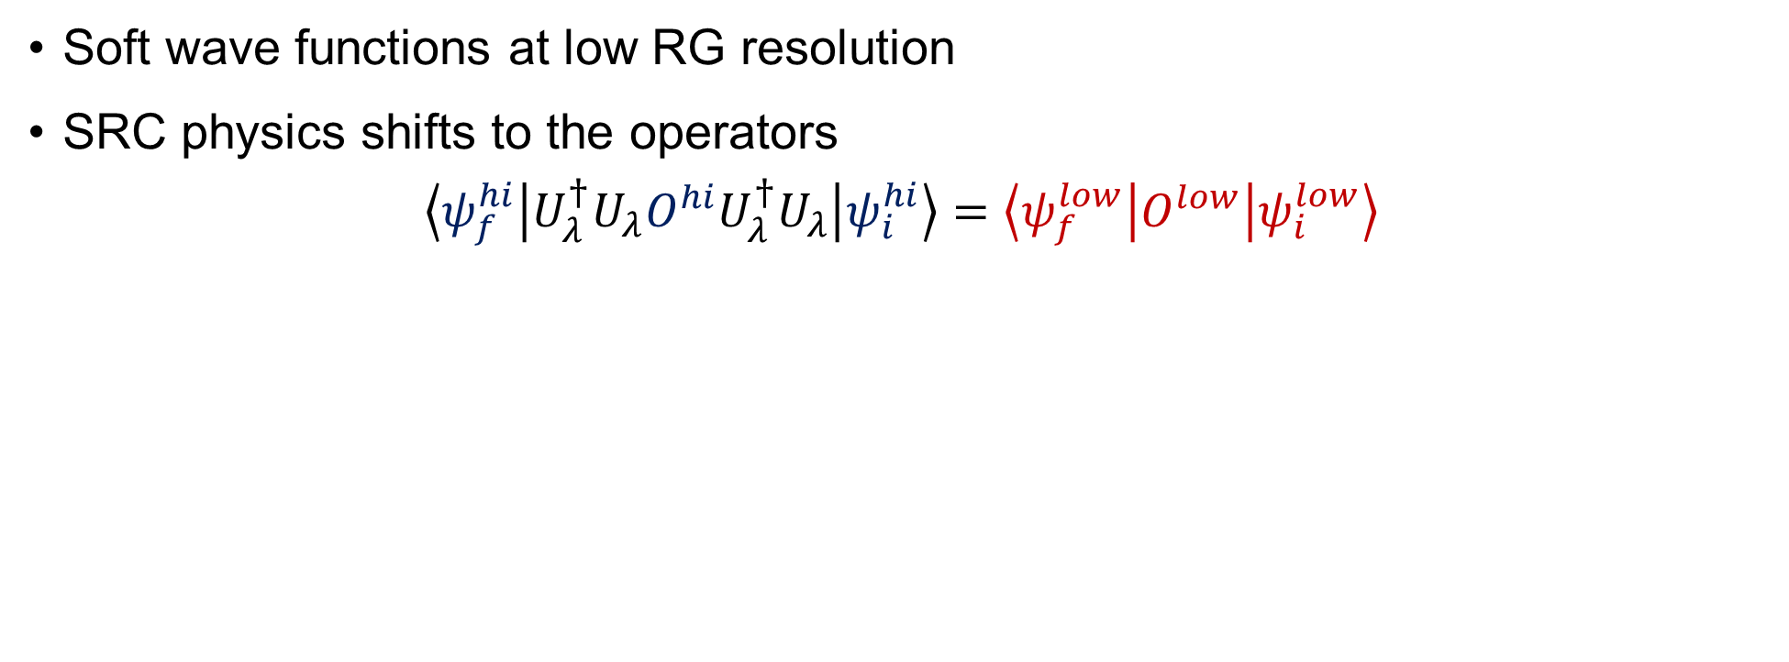
Operator evolution
Soft wave functions at low RG resolution
SRC physics shifts to the operators
$$\left\langle ψ_{f}^{hi} | U_{λ}^{†}U_{λ}O^{hi}U_{λ}^{†}U_{λ} | ψ_{i}^{hi}\right\rangle =\left\langle ψ_{f}^{low} | O^{low} | ψ_{i}^{low}\right\rangle$$
Notes:
Recap: first bullet.
The SRC physics is shifted to the operators at low RG resolution which can be seen in the following equation.
Explain equation.

Slide 14
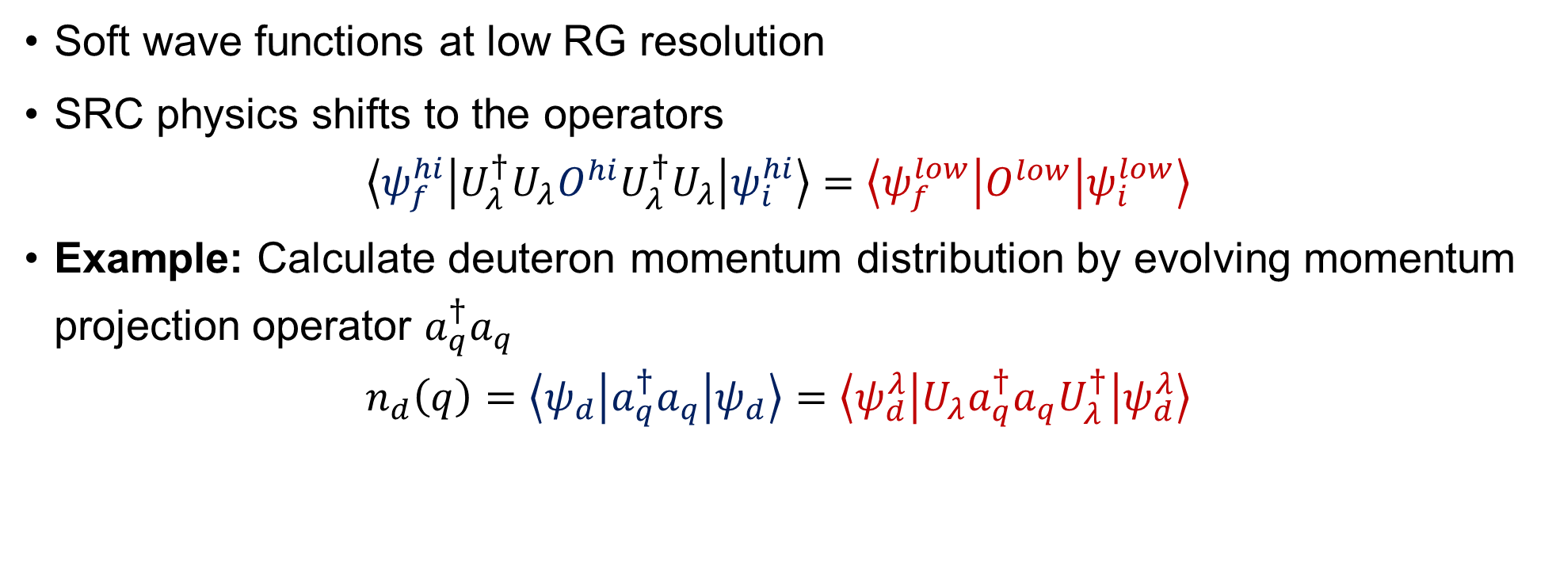
Operator evolution
Soft wave functions at low RG resolution
SRC physics shifts to the operators
$$\left\langle ψ_{f}^{hi} | U_{λ}^{†}U_{λ}O^{hi}U_{λ}^{†}U_{λ} | ψ_{i}^{hi}\right\rangle =\left\langle ψ_{f}^{low} | O^{low} | ψ_{i}^{low}\right\rangle$$
Example: Calculate deuteron momentum distribution by evolving momentum projection operator $a_{q}^{†}a_{q}$
$$n_{d}\left(q\right)=\left\langle ψ_{d} | a_{q}^{†}a_{q} | ψ_{d}\right\rangle =\left\langle ψ_{d}^{λ} | {U_{λ}a}_{q}^{†}a_{q}U_{λ}^{†} | ψ_{d}^{λ}\right\rangle$$
Notes:
As an example, I’ll show how this can be applied to the momentum distribution of deuteron by evolving both the wave function and momentum projection operator given by \ataq.

Slide 15
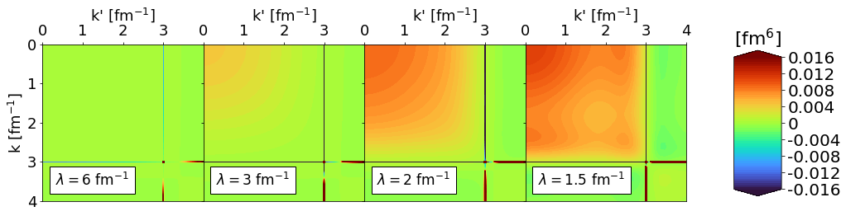
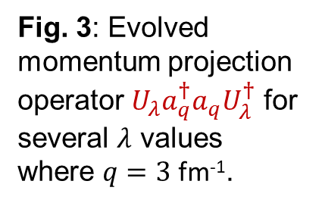
Operator evolution
Fig. 3: Evolved momentum projection operator ${U_{λ}a}_{q}^{†}a_{q}U_{λ}^{†}$ for several $λ$ values where $q=3$ fm⁻¹.
Notes:
Explain what this figure is first: This is the evolved momentum projection operator in momentum space for a particular q value: so U and Udag applied to \ataq for q=3.

Slide 16
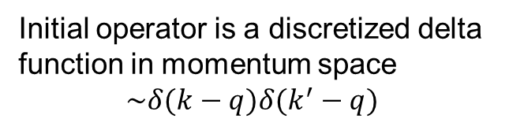
Operator evolution
Fig. 3: Evolved momentum projection operator ${U_{λ}a}_{q}^{†}a_{q}U_{λ}^{†}$ for several $λ$ values where $q=3$ fm⁻¹.
RG Scale
Initial operator is a discretized delta function in momentum space
$$\sim δ(k−q)δ(k^{′}−q)$$
SRG evolution induces smooth, low-momentum contributions
Notes:
Explain key features: Discretized delta function, RG scale, smooth induced contributions at low momentum reproduce UV physics of the original NN potential.

Slide 17
Operator evolution
Fig. 3: Evolved momentum projection operator ${U_{λ}a}_{q}^{†}a_{q}U_{λ}^{†}$ for several $λ$ values where $q=3$ fm⁻¹.
SRG evolution of hard potential does NOT make the reaction operator hard!
RG Scale
Initial operator is a discretized delta function in momentum space
$$\sim δ(k−q)δ(k^{′}−q)$$
SRG evolution induces smooth, low-momentum contributions
Notes:
Reiterate: evolved operator has smooth low-k induced contributions (which are smeared delta functions in coordinate space).

Slide 18
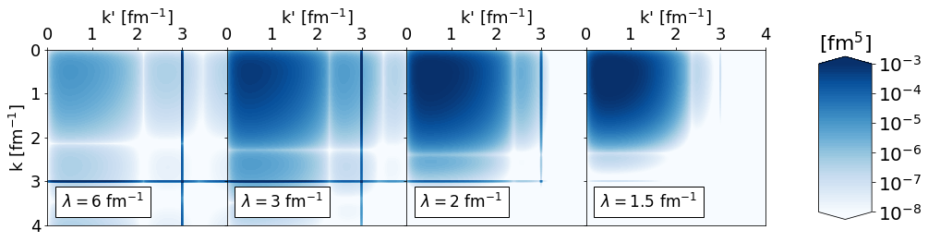
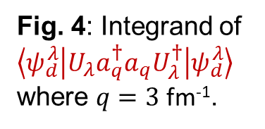
Operator evolution
Fig. 3: Evolved momentum projection operator ${U_{λ}a}_{q}^{†}a_{q}U_{λ}^{†}$ for several $λ$ values where $q=3$ fm⁻¹.
Fig. 4: Integrand of $\left\langle ψ_{d}^{λ} | {U_{λ}a}_{q}^{†}a_{q}U_{λ}^{†} | ψ_{d}^{λ}\right\rangle$where $q=3$ fm⁻¹.
Notes:
Explain next figure in great detail.

Slide 19
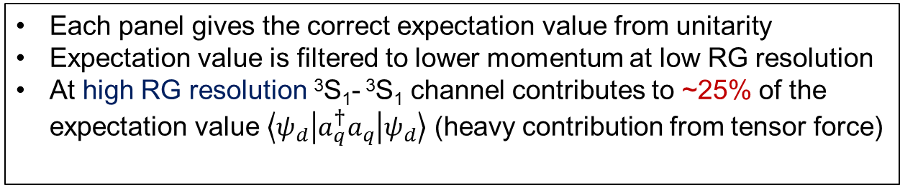
Operator evolution
Fig. 3: Evolved momentum projection operator ${U_{λ}a}_{q}^{†}a_{q}U_{λ}^{†}$ for several $λ$ values where $q=3$ fm⁻¹.
Each panel gives the correct expectation value from unitarity
Expectation value is filtered to lower momentum at low RG resolution
At high RG resolution ³S₁- ³S₁ channel contributes to ~25% of the expectation value $\left\langle ψ_{d} | a_{q}^{†}a_{q} | ψ_{d}\right\rangle$ (heavy contribution from tensor force)
Fig. 4: Integrand of $\left\langle ψ_{d}^{λ} | {U_{λ}a}_{q}^{†}a_{q}U_{λ}^{†} | ψ_{d}^{λ}\right\rangle$where $q=3$ fm⁻¹.
Notes:
Read the bullets.

Slide 20
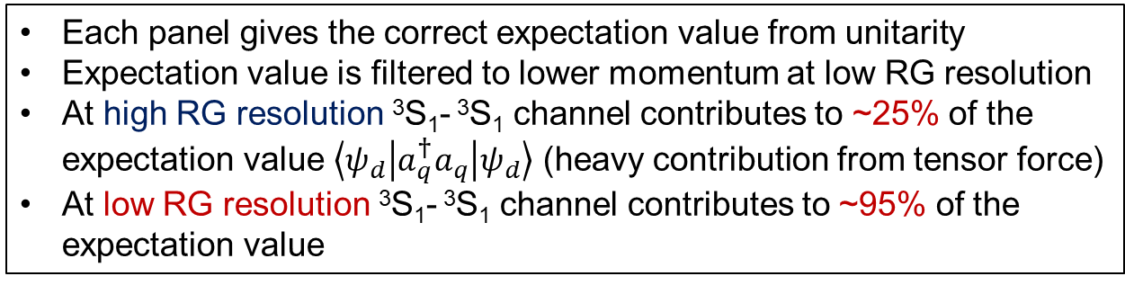
Operator evolution
Fig. 3: Evolved momentum projection operator ${U_{λ}a}_{q}^{†}a_{q}U_{λ}^{†}$ for several $λ$ values where $q=3$ fm⁻¹.
Each panel gives the correct expectation value from unitarity
Expectation value is filtered to lower momentum at low RG resolution
At high RG resolution ³S₁- ³S₁ channel contributes to ~25% of the expectation value $\left\langle ψ_{d} | a_{q}^{†}a_{q} | ψ_{d}\right\rangle$ (heavy contribution from tensor force)
At low RG resolution ³S₁- ³S₁ channel contributes to ~95% of the expectation value
Fig. 4: Integrand of $\left\langle ψ_{d}^{λ} | {U_{λ}a}_{q}^{†}a_{q}U_{λ}^{†} | ψ_{d}^{λ}\right\rangle$where $q=3$ fm⁻¹.
Notes:
Read the last bullet. Emphasize that the expectation value will not change but the underlying calculation itself does.

Slide 21
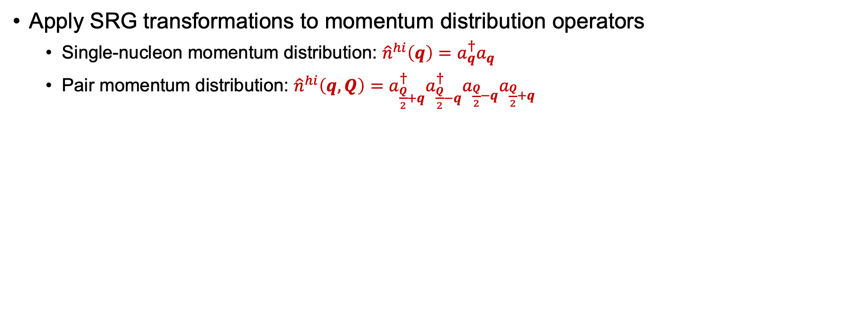
Momentum distributions at low RG resolution
Apply SRG transformations to momentum distribution operators
Single-nucleon momentum distribution: ${\hat{n}}^{hi}\left(q\right)=a_{q}^{†}a_{q}$
Pair momentum distribution: ${\hat{n}}^{hi}\left(q,Q\right)=a_{\frac{Q}{2}+q}^{†}{a_{\frac{Q}{2}−q}^{†}a}_{\frac{Q}{2}−q}a_{\frac{Q}{2}+q}$
Notes:
We will next walk through how this works with second quantized formulas.
The two operators we’ll consider are the single-nucleon and pair momentum distribution operators.

Slide 22
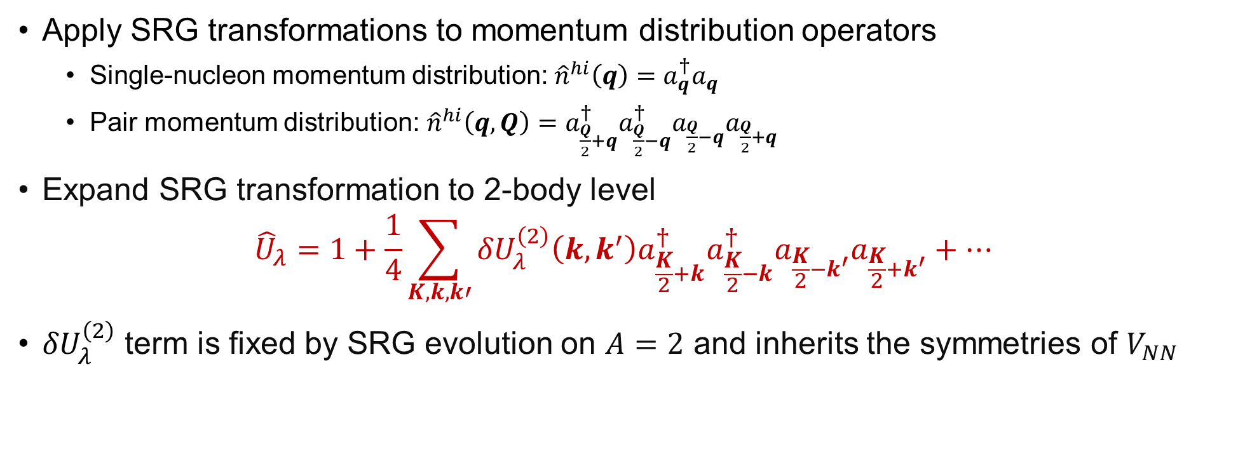
Momentum distributions at low RG resolution
Apply SRG transformations to momentum distribution operators
Single-nucleon momentum distribution: ${\hat{n}}^{hi}\left(q\right)=a_{q}^{†}a_{q}$
Pair momentum distribution: ${\hat{n}}^{hi}\left(q,Q\right)=a_{\frac{Q}{2}+q}^{†}{a_{\frac{Q}{2}−q}^{†}a}_{\frac{Q}{2}−q}a_{\frac{Q}{2}+q}$
Expand SRG transformation to 2-body level
$${\hat{U}}_{λ}=1+\frac{1}{4}\sum_{K,k,k′}{{δU}_{λ}^{\left(2\right)}\left(k,k^{′}\right)a_{\frac{K}{2}+k}^{†}a_{\frac{K}{2}−k}^{†}a_{\frac{K}{2}−k^{′}}a_{\frac{K}{2}+k^{′}}+⋯}$$
${δU}_{λ}^{\left(2\right)}$ term is fixed by SRG evolution on $A=2$ and inherits the symmetries of $V_{NN}$
Notes:
We expand the SRG transformation to 2-body level, so 1 + this two body term: \delta U.
Read last bullet (and inherits the symmetries of the NN potential like Galilean invariance and expansion in partial waves).

Slide 23
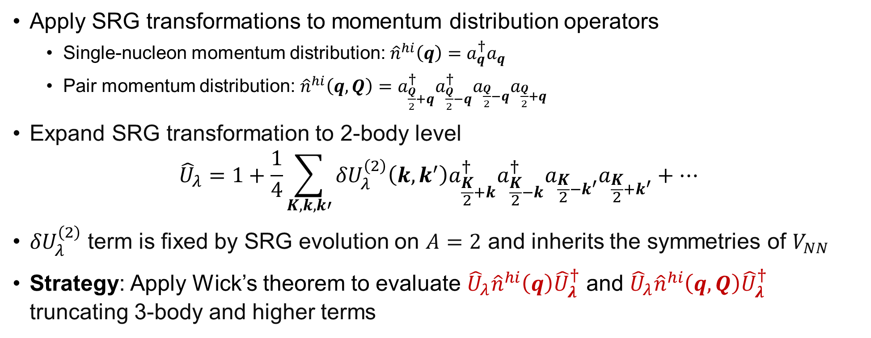
Momentum distributions at low RG resolution
Apply SRG transformations to momentum distribution operators
Single-nucleon momentum distribution: ${\hat{n}}^{hi}\left(q\right)=a_{q}^{†}a_{q}$
Pair momentum distribution: ${\hat{n}}^{hi}\left(q,Q\right)=a_{\frac{Q}{2}+q}^{†}{a_{\frac{Q}{2}−q}^{†}a}_{\frac{Q}{2}−q}a_{\frac{Q}{2}+q}$
Expand SRG transformation to 2-body level
$${\hat{U}}_{λ}=1+\frac{1}{4}\sum_{K,k,k′}{{δU}_{λ}^{\left(2\right)}\left(k,k^{′}\right)a_{\frac{K}{2}+k}^{†}a_{\frac{K}{2}−k}^{†}a_{\frac{K}{2}−k^{′}}a_{\frac{K}{2}+k^{′}}+⋯}$$
${δU}_{λ}^{\left(2\right)}$ term is fixed by SRG evolution on $A=2$ and inherits the symmetries of $V_{NN}$
Strategy: Apply Wick’s theorem to evaluate ${\hat{U}}_{λ}{\hat{n}}^{hi}\left(q\right){\hat{U}}_{λ}^{†}$ and ${\hat{U}}_{λ}{\hat{n}}^{hi}\left(q,Q\right){\hat{U}}_{λ}^{†}$ truncating 3-body and higher terms
Notes:
The strategy is to apply WT to evaluate the evolved operator truncating 3-body and higher terms.

Slide 24
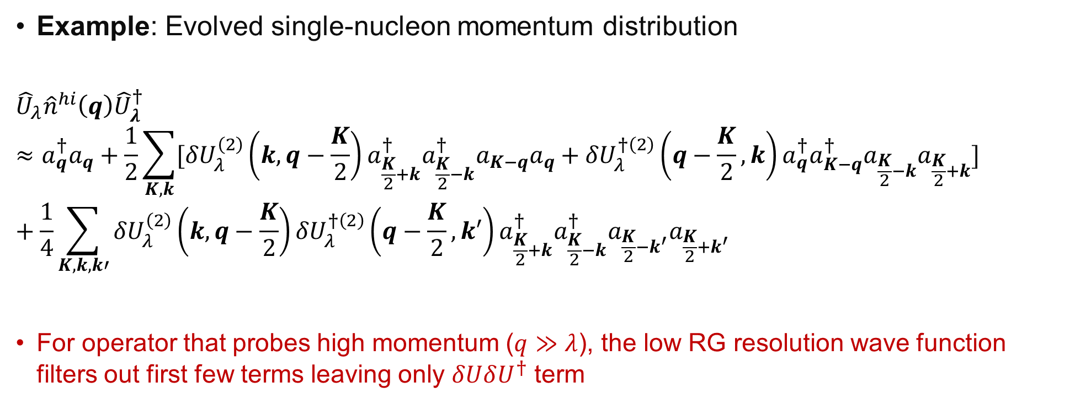
Momentum distributions at low RG resolution
Example: Evolved single-nucleon momentum distribution
$${\hat{U}}_{λ}{\hat{n}}^{hi}\left(q\right){\hat{U}}_{λ}^{†}≈a_{q}^{†}a_{q}+\frac{1}{2}\sum_{K,k}{[{δU}_{λ}^{\left(2\right)}\left(k,q−\frac{K}{2}\right)a_{\frac{K}{2}+k}^{†}a_{\frac{K}{2}−k}^{†}a_{K−q}a_{q}+{δU}_{λ}^{†\left(2\right)}\left(q−\frac{K}{2},k\right)a_{q}^{†}a_{K−q}^{†}a_{\frac{K}{2}−k}a_{\frac{K}{2}+k}}]+\frac{1}{4}\sum_{K,k,k′}{{δU}_{λ}^{\left(2\right)}\left(k,q−\frac{K}{2}\right)}{δU}_{λ}^{†\left(2\right)}\left(q−\frac{K}{2},k′\right)a_{\frac{K}{2}+k}^{†}a_{\frac{K}{2}−k}^{†}a_{\frac{K}{2}−k^{′}}a_{\frac{K}{2}+k^{′}}$$
For operator that probes high momentum ($q≫λ$), the low RG resolution wave function filters out first few terms leaving only $δUδU^{†}$ term
Notes:
This is what the expression for the single-nucleon momentum distribution looks like after truncating at the 2-body level.
Go through each term.
Read last bullet.

Slide 25
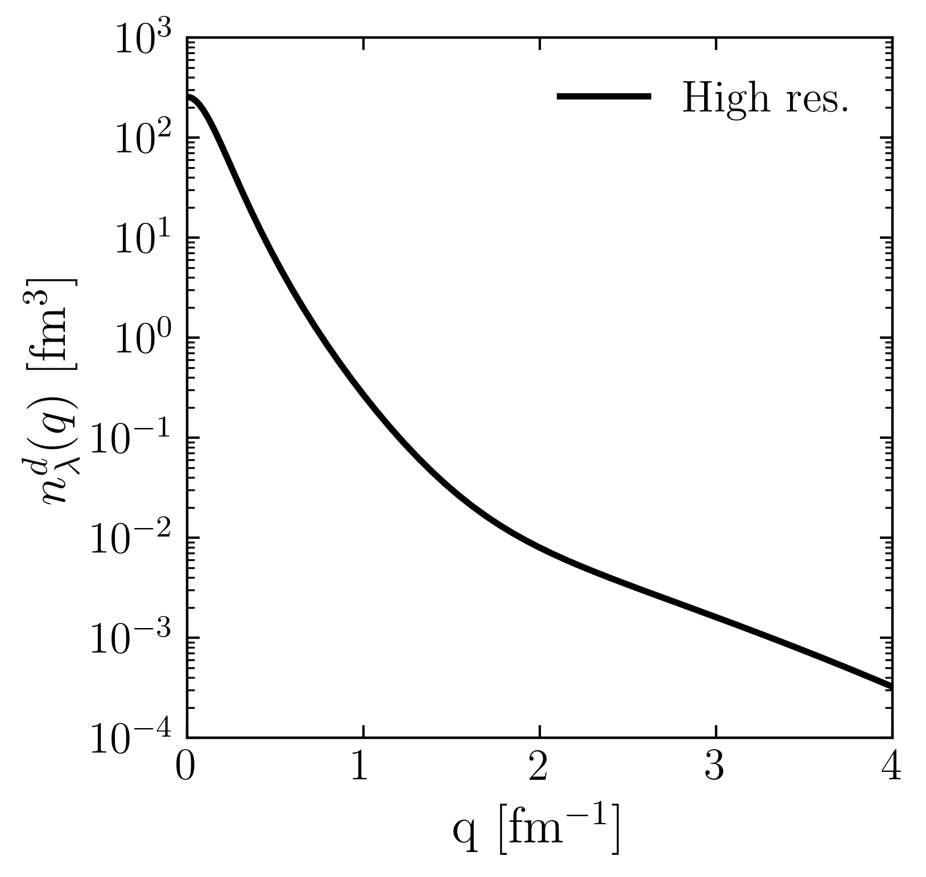
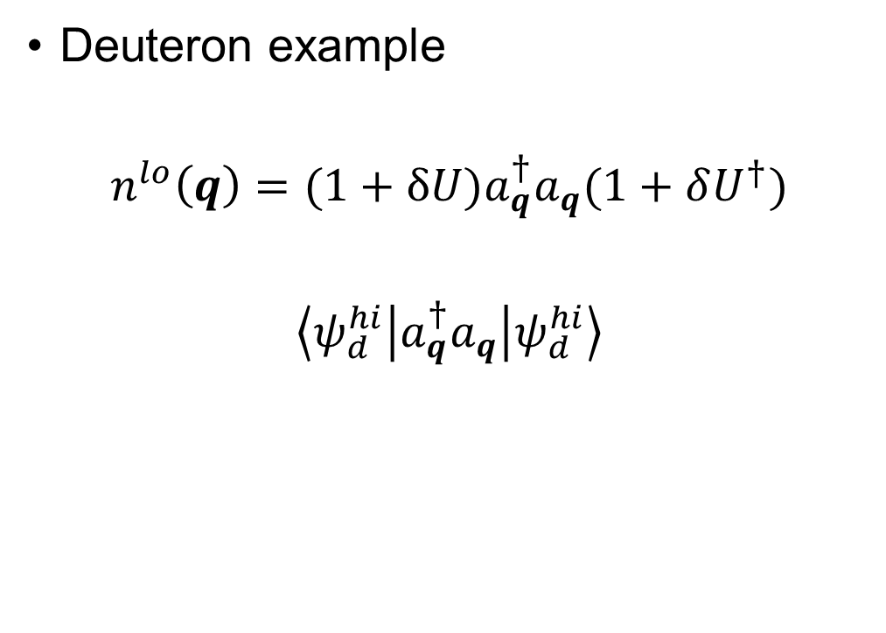
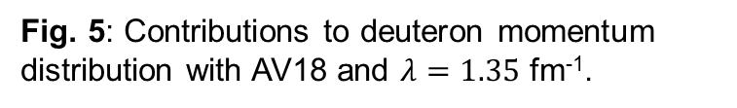
Momentum distributions at low RG resolution
Deuteron example
$$n^{lo}\left(q\right)=(1+δU)a_{q}^{†}a_{q}(1+δU^{†})$$
$$\left\langle ψ_{d}^{hi} | a_{q}^{†}a_{q} | ψ_{d}^{hi}\right\rangle$$
Fig. 5: Contributions to deuteron momentum distribution with AV18 and $λ=1.35$ fm⁻¹.
Notes:
Use deuteron in momentum space as an example and consider contributions to the full distribution in terms of 1 and \delta U.
Here is the full result with the high RG resolution wave function and operator.

Slide 26
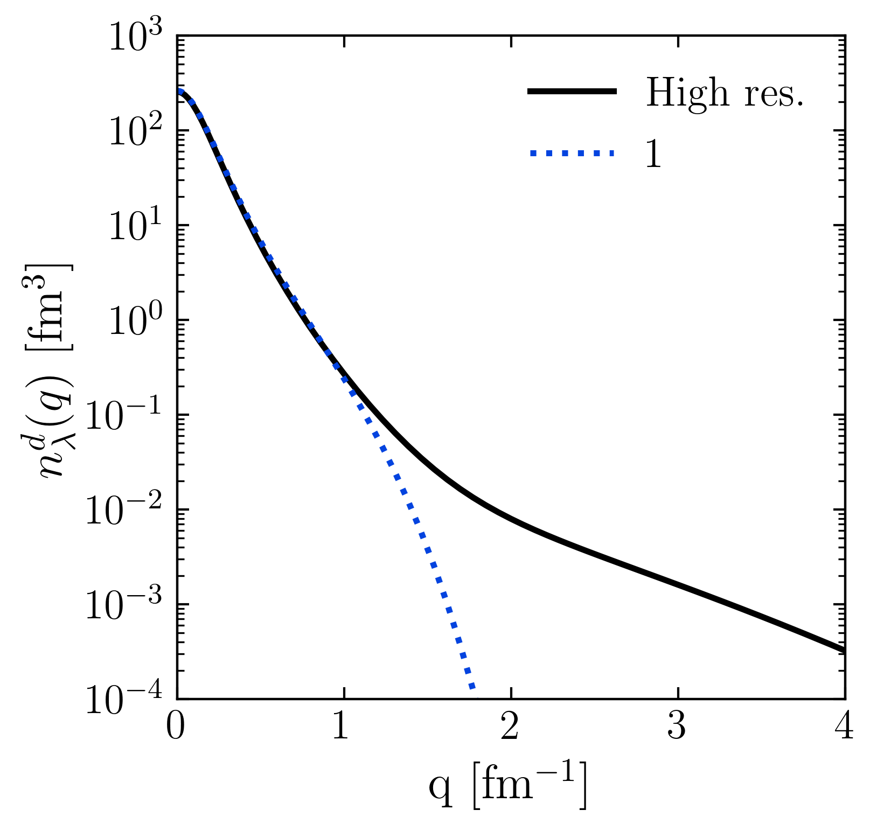
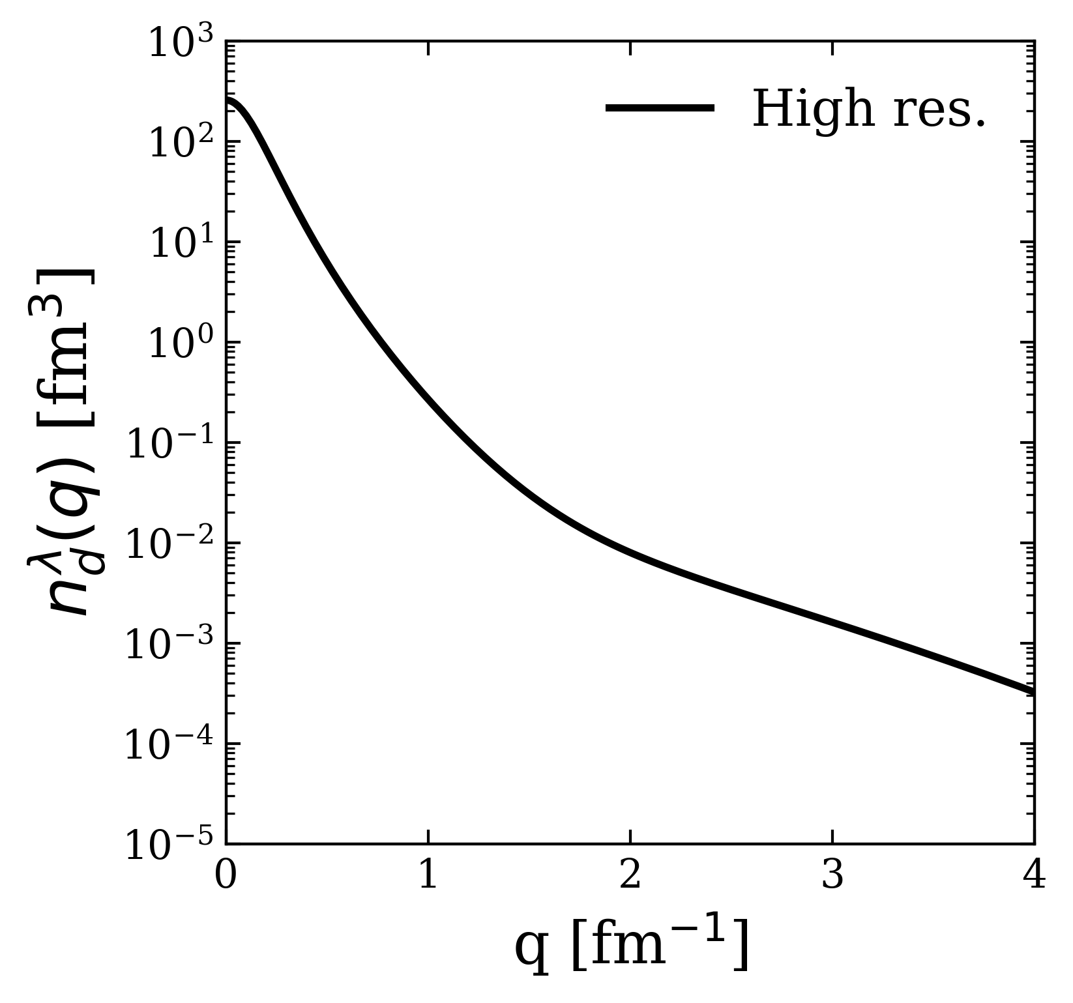
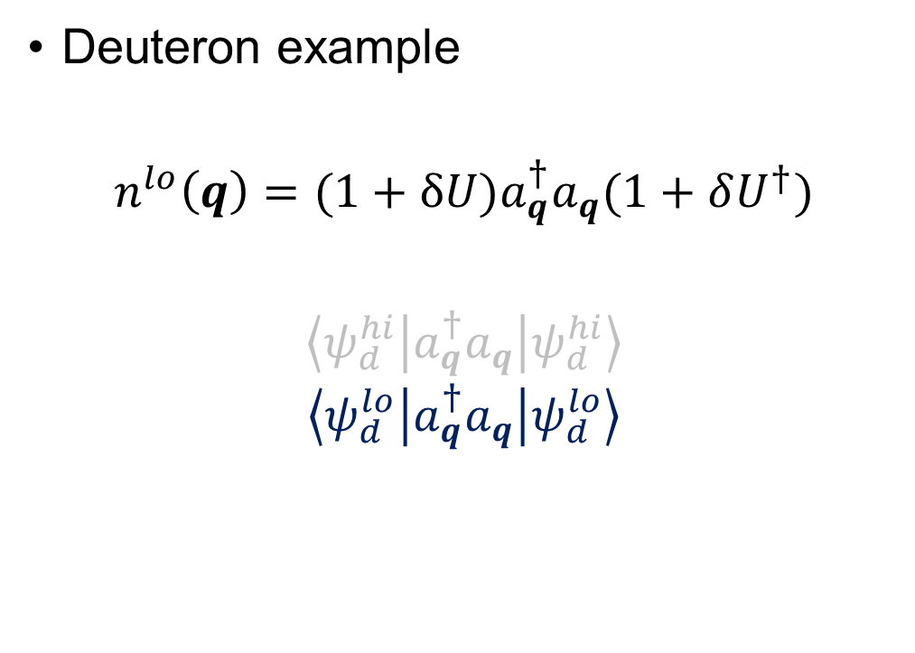
Momentum distributions at low RG resolution
Deuteron example
$$n^{lo}\left(q\right)=(1+δU)a_{q}^{†}a_{q}(1+δU^{†})$$
$$\left\langle ψ_{d}^{hi} | a_{q}^{†}a_{q} | ψ_{d}^{hi}\right\rangle$$
$$\left\langle ψ_{d}^{lo} | a_{q}^{†}a_{q} | ψ_{d}^{lo}\right\rangle$$
Fig. 5: Contributions to deuteron momentum distribution with AV18 and $λ=1.35$ fm⁻¹.
Notes:
Taking only 1.

Slide 27
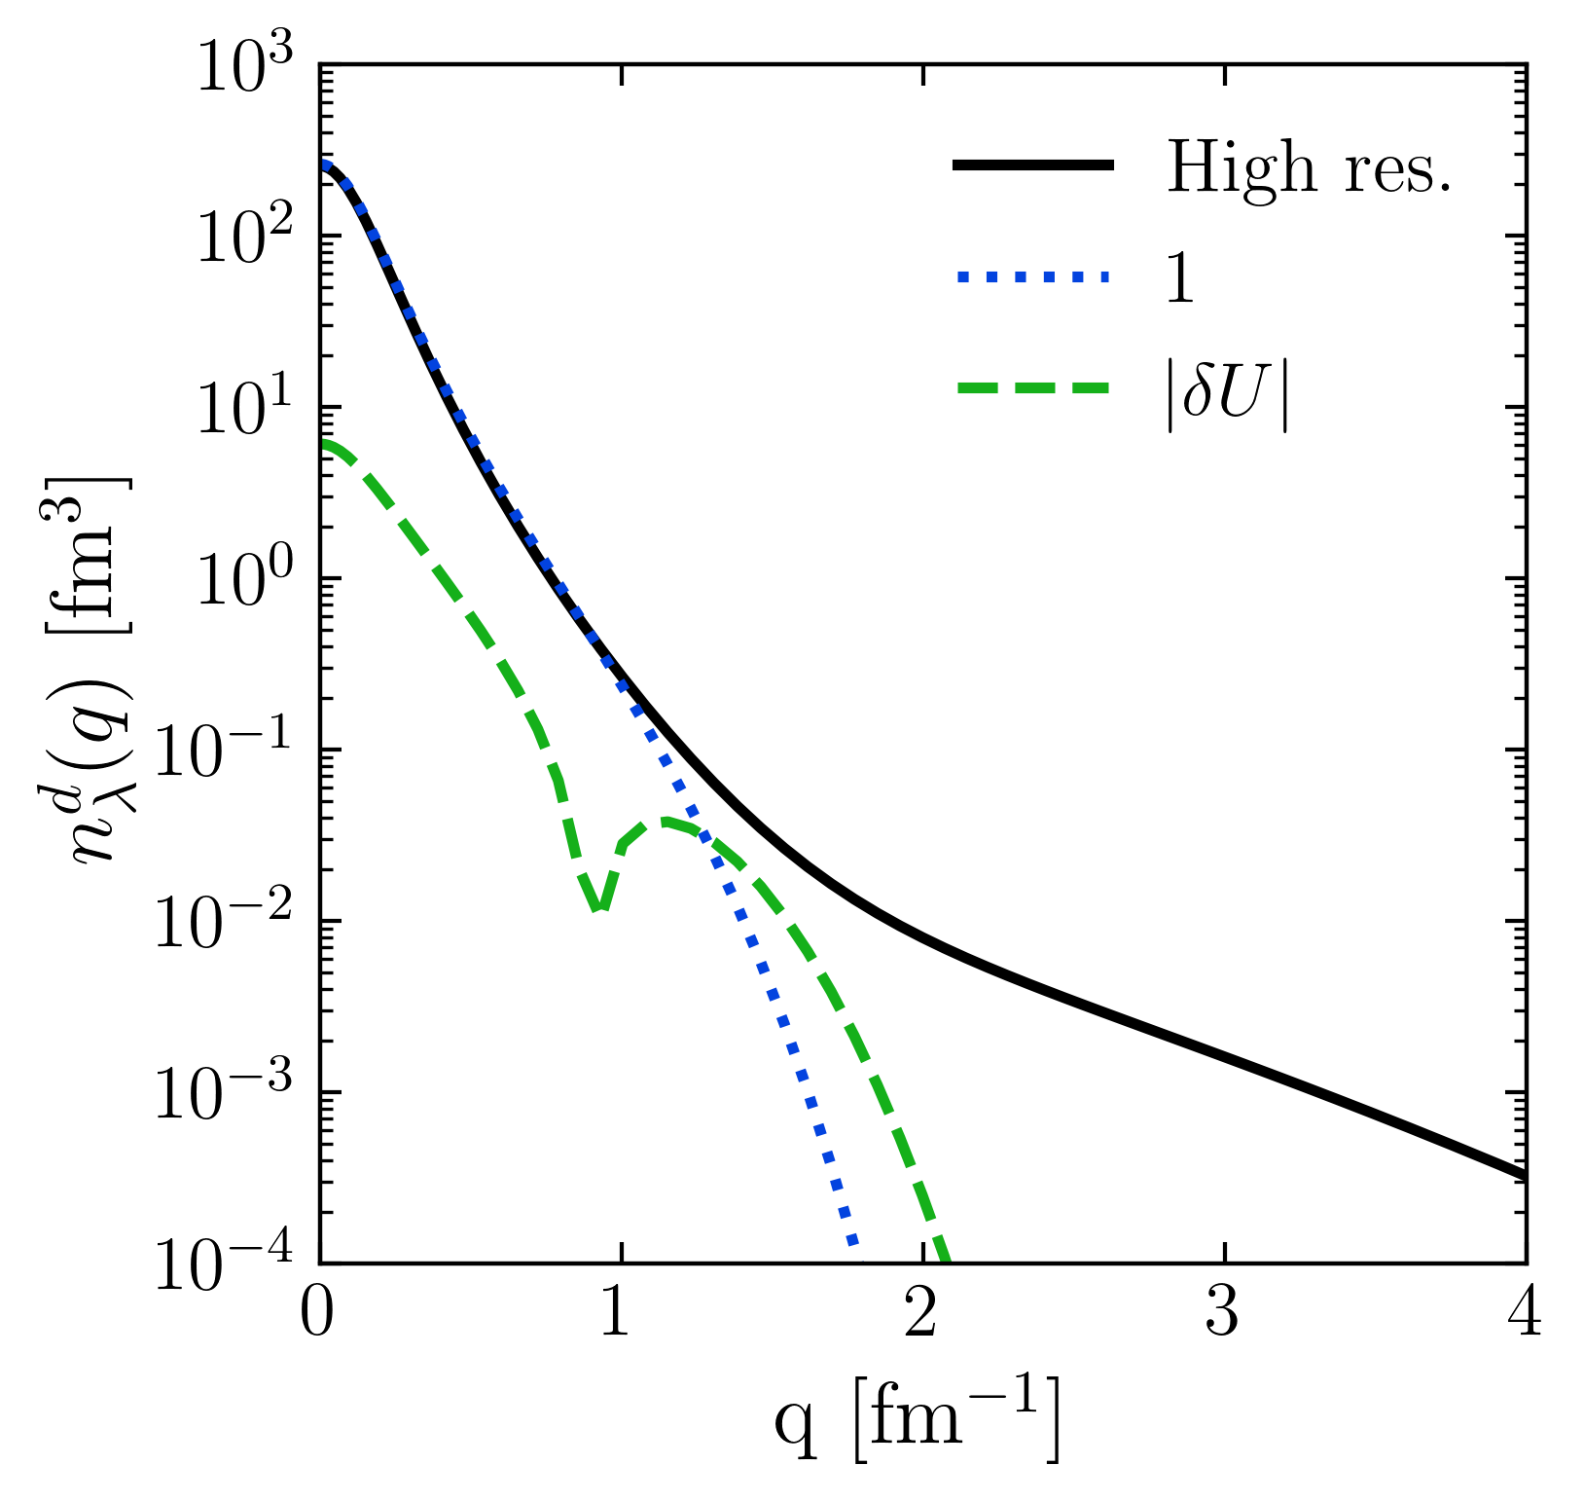
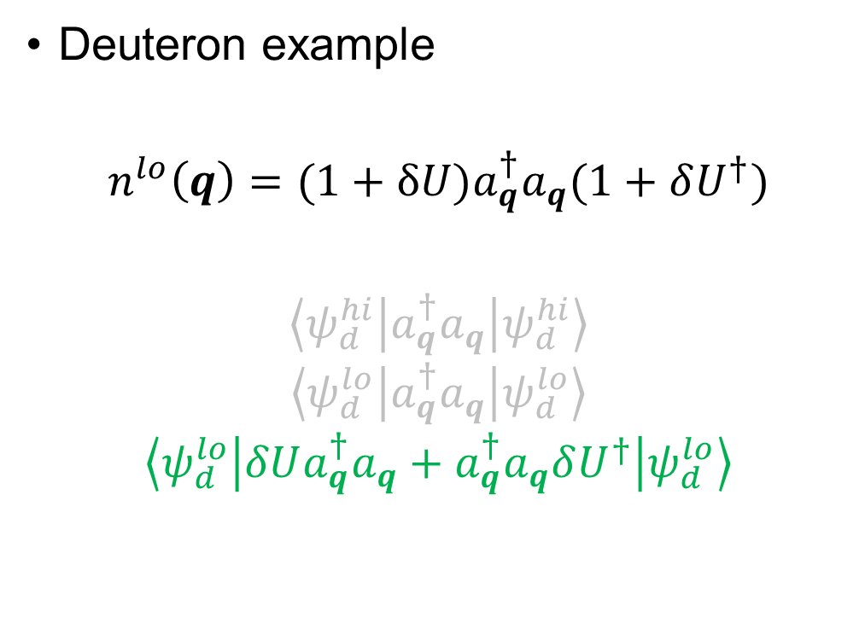
Momentum distributions at low RG resolution
Deuteron example
$$n^{lo}\left(q\right)=(1+δU)a_{q}^{†}a_{q}(1+δU^{†})$$
$$\left\langle ψ_{d}^{hi} | a_{q}^{†}a_{q} | ψ_{d}^{hi}\right\rangle$$
$$\left\langle ψ_{d}^{lo} | a_{q}^{†}a_{q} | ψ_{d}^{lo}\right\rangle$$
$$\left\langle ψ_{d}^{lo} | δUa_{q}^{†}a_{q}+a_{q}^{†}a_{q}δU^{†} | ψ_{d}^{lo}\right\rangle$$
Fig. 5: Contributions to deuteron momentum distribution with AV18 and $λ=1.35$ fm⁻¹.
Notes:
Taking only \delta U.

Slide 28
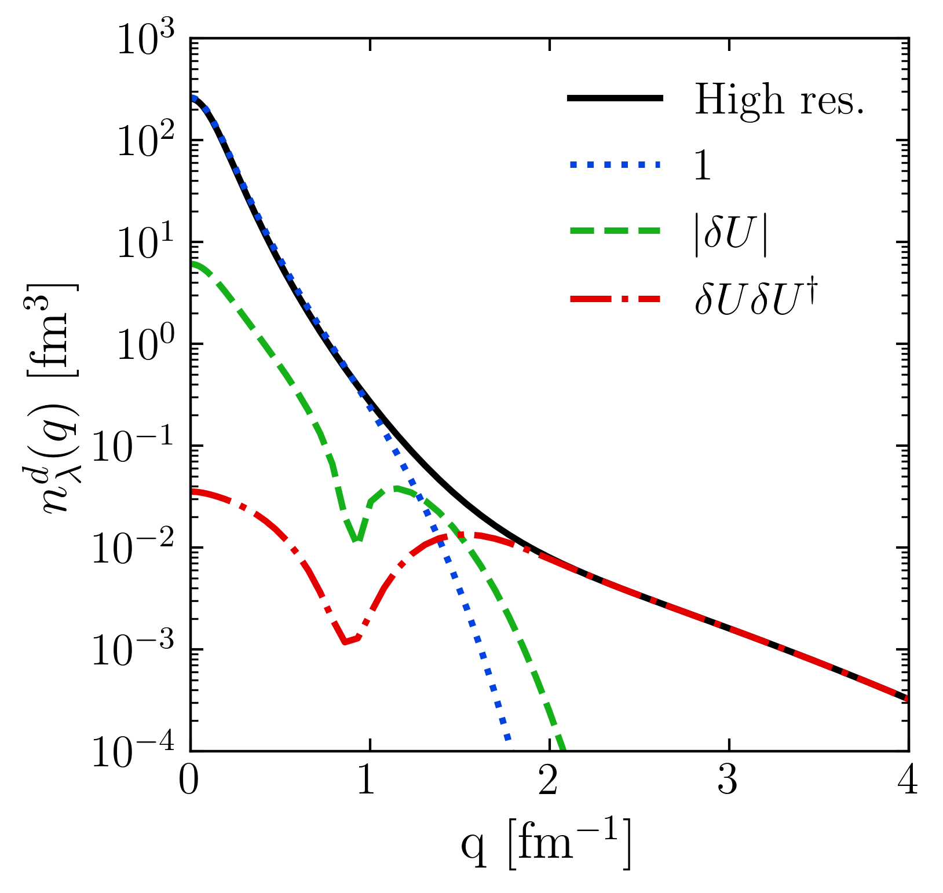
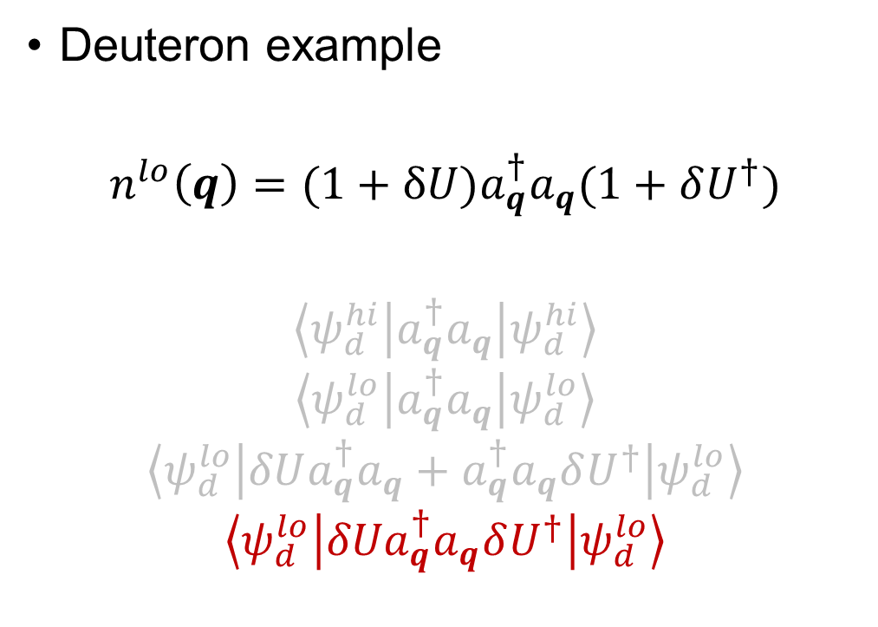
Momentum distributions at low RG resolution
Deuteron example
$$n^{lo}\left(q\right)=(1+δU)a_{q}^{†}a_{q}(1+δU^{†})$$
$$\left\langle ψ_{d}^{hi} | a_{q}^{†}a_{q} | ψ_{d}^{hi}\right\rangle$$
$$\left\langle ψ_{d}^{lo} | a_{q}^{†}a_{q} | ψ_{d}^{lo}\right\rangle$$
$$\left\langle ψ_{d}^{lo} | δUa_{q}^{†}a_{q}+a_{q}^{†}a_{q}δU^{†} | ψ_{d}^{lo}\right\rangle$$
$$\left\langle ψ_{d}^{lo} | {δUa}_{q}^{†}a_{q}δU^{†} | ψ_{d}^{lo}\right\rangle$$
Fig. 5: Contributions to deuteron momentum distribution with AV18 and $λ=1.35$ fm⁻¹.
Notes:
Taking \delta U \delta U^\dagger -> gives high-momentum tail.

Slide 29
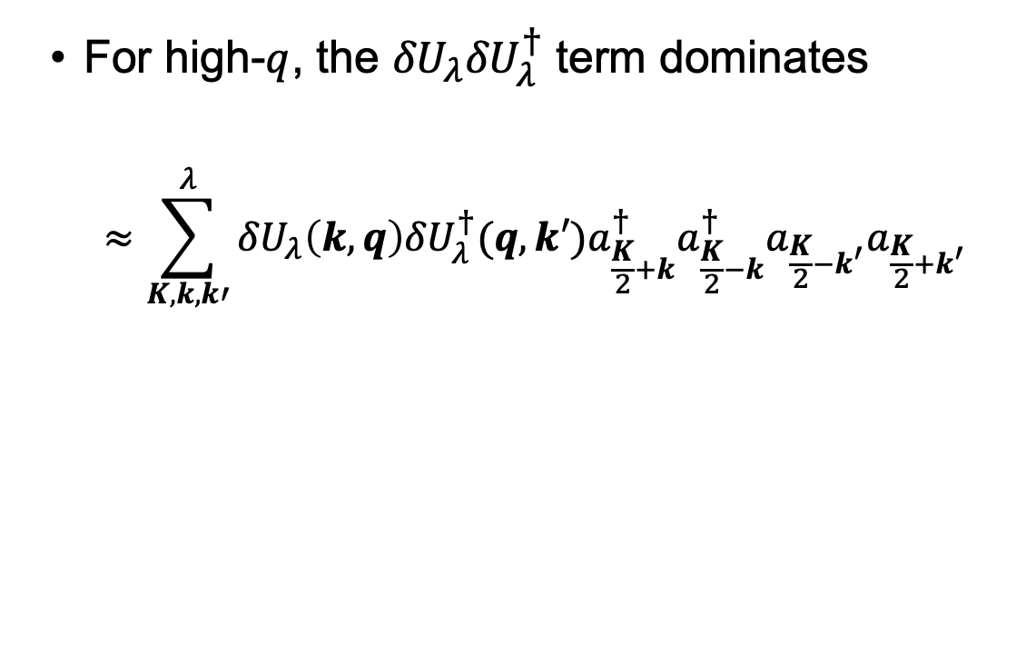
Momentum distributions at low RG resolution
For high-$q$, the ${δU}_{λ}{δU}_{λ}^{†}$ term dominates
$$≈\sum_{K,k,k′}^{λ}{{δU}_{λ}\left(k,q\right){{δU}_{λ}^{†}(q,k′)a}_{\frac{K}{2}+k}^{†}a_{\frac{K}{2}−k}^{†}a_{\frac{K}{2}−k^{′}}a_{\frac{K}{2}+k^{′}}}$$
Fig. 5: Contributions to deuteron momentum distribution with AV18 and $λ=1.35$ fm⁻¹.
Notes:
Read bullet.

Slide 30
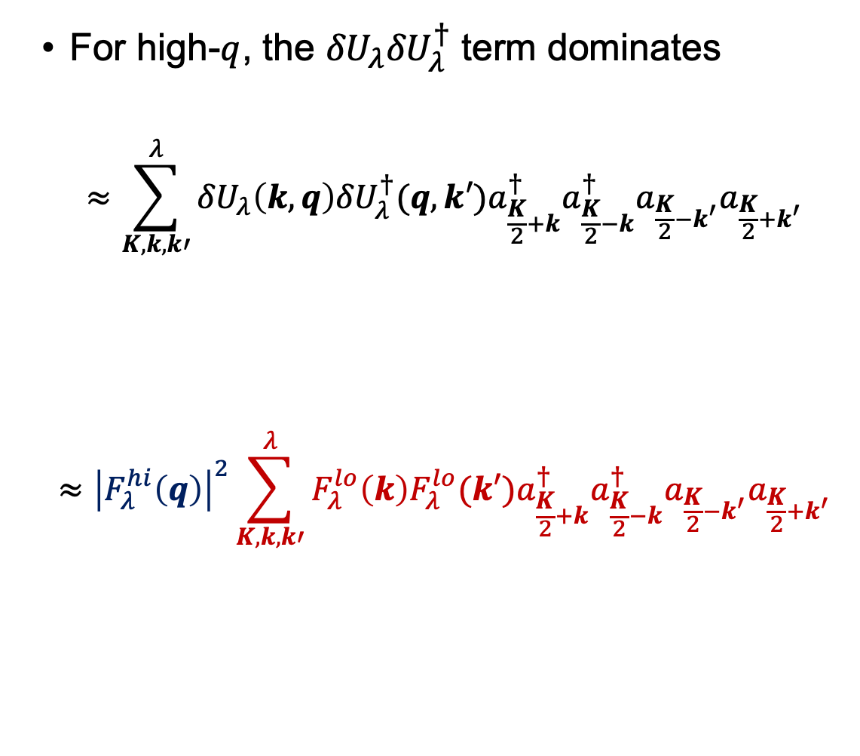
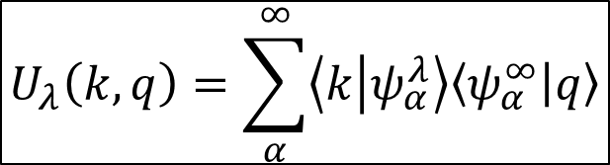
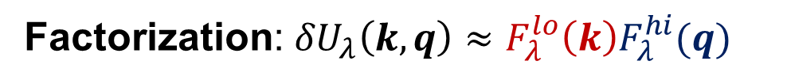
Momentum distributions at low RG resolution
For high-$q$, the ${δU}_{λ}{δU}_{λ}^{†}$ term dominates
$$≈\sum_{K,k,k′}^{λ}{{δU}_{λ}\left(k,q\right){{δU}_{λ}^{†}(q,k′)a}_{\frac{K}{2}+k}^{†}a_{\frac{K}{2}−k}^{†}a_{\frac{K}{2}−k^{′}}a_{\frac{K}{2}+k^{′}}}$$
$$≈{\left|F_{λ}^{hi}\left(q\right)\right|}^{2}\sum_{K,k,k′}^{λ}{F_{λ}^{lo}\left(k\right){F_{λ}^{lo}(k′)a}_{\frac{K}{2}+k}^{†}a_{\frac{K}{2}−k}^{†}a_{\frac{K}{2}−k^{′}}a_{\frac{K}{2}+k^{′}}}$$
$$U_{λ}\left(k,q\right)=\sum_{α}^{∞}{\left\langle k | ψ_{α}^{λ}\right\rangle \left\langle ψ_{α}^{∞} | q\right\rangle }$$
Factorization: ${δU}_{λ}\left(k,q\right)≈F_{λ}^{lo}{\left(k\right)F}_{λ}^{hi}(q)$
Fig. 5: Contributions to deuteron momentum distribution with AV18 and $λ=1.35$ fm⁻¹.
Notes:
Furthermore, relying on the spectral representation of the SRG transformation, we can derive that these transformations factorize into a function of high and low momentum as such when k is low and q much higher than \lambda.
So we are left with the high-momentum dependence out in front here (point) and the rest is at low momentum (well reproduced by MF).

Slide 31
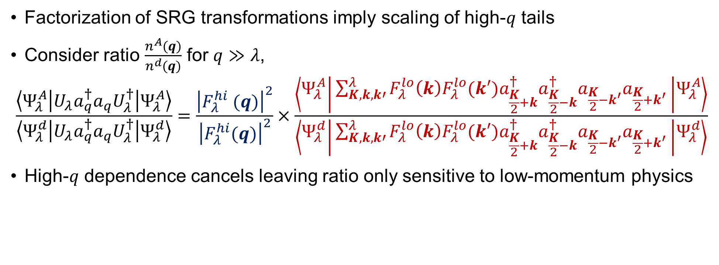
Factorization
Factorization of SRG transformations imply scaling of high-$q$ tails
Consider ratio $\frac{n^{A}(q)}{n^{d}(q)}$ for $q≫λ$,
$$\frac{\left\langle Ψ_{λ}^{A} | {U_{λ}a}_{q}^{†}a_{q}U_{λ}^{†} | Ψ_{λ}^{A}\right\rangle }{\left\langle Ψ_{λ}^{d} | {U_{λ}a}_{q}^{†}a_{q}U_{λ}^{†} | Ψ_{λ}^{d}\right\rangle }=\frac{{\left|F_{λ}^{hi} (q)\right|}^{2}}{{\left|F_{λ}^{hi}(q)\right|}^{2}}×\frac{\left\langle Ψ_{λ}^{A} | \sum_{K,k,k′}^{λ}{F_{λ}^{lo}\left(k\right){F_{λ}^{lo}(k′)a}_{\frac{K}{2}+k}^{†}a_{\frac{K}{2}−k}^{†}a_{\frac{K}{2}−k^{′}}a_{\frac{K}{2}+k^{′}}} | Ψ_{λ}^{A}\right\rangle }{\left\langle Ψ_{λ}^{d} | \sum_{K,k,k′}^{λ}{F_{λ}^{lo}\left(k\right){F_{λ}^{lo}(k′)a}_{\frac{K}{2}+k}^{†}a_{\frac{K}{2}−k}^{†}a_{\frac{K}{2}−k^{′}}a_{\frac{K}{2}+k^{′}}} | Ψ_{λ}^{d}\right\rangle }$$
High-$q$ dependence cancels leaving ratio only sensitive to low-momentum physics
Notes:
This factorization implies scaling of high momentum tails.
Consider the ratio of an A-body nuclear momentum distribution over the deuteron momentum distribution for high-q.
In this ratio, the 2-body high-q pieces cancel leaving (read last bullet).

Slide 32
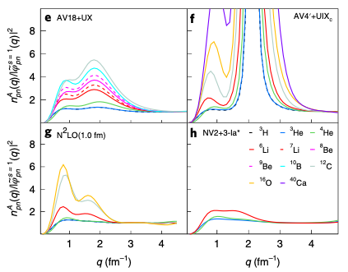
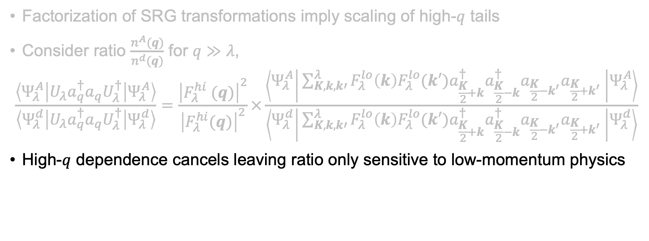
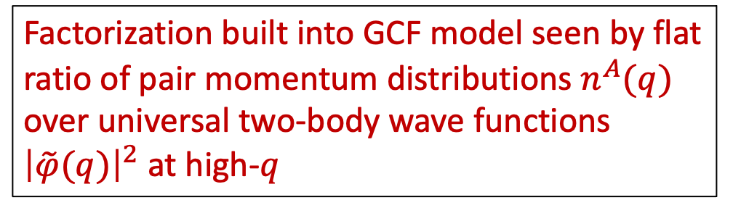
Factorization
Figure from R. Cruz-Torres et al., Nat. Phys. 17, 306 (2021)
Factorization of SRG transformations imply scaling of high-$q$ tails
Consider ratio $\frac{n^{A}(q)}{n^{d}(q)}$ for $q≫λ$,
$$\frac{\left\langle Ψ_{λ}^{A} | {U_{λ}a}_{q}^{†}a_{q}U_{λ}^{†} | Ψ_{λ}^{A}\right\rangle }{\left\langle Ψ_{λ}^{d} | {U_{λ}a}_{q}^{†}a_{q}U_{λ}^{†} | Ψ_{λ}^{d}\right\rangle }=\frac{{\left|F_{λ}^{hi} (q)\right|}^{2}}{{\left|F_{λ}^{hi}(q)\right|}^{2}}×\frac{\left\langle Ψ_{λ}^{A} | \sum_{K,k,k′}^{λ}{F_{λ}^{lo}\left(k\right){F_{λ}^{lo}(k′)a}_{\frac{K}{2}+k}^{†}a_{\frac{K}{2}−k}^{†}a_{\frac{K}{2}−k^{′}}a_{\frac{K}{2}+k^{′}}} | Ψ_{λ}^{A}\right\rangle }{\left\langle Ψ_{λ}^{d} | \sum_{K,k,k′}^{λ}{F_{λ}^{lo}\left(k\right){F_{λ}^{lo}(k′)a}_{\frac{K}{2}+k}^{†}a_{\frac{K}{2}−k}^{†}a_{\frac{K}{2}−k^{′}}a_{\frac{K}{2}+k^{′}}} | Ψ_{λ}^{d}\right\rangle }$$
High-$q$ dependence cancels leaving ratio only sensitive to low-momentum physics
Factorization built into GCF model seen by flat ratio of pair momentum distributions $n^{A}(q)$ over universal two-body wave functions ${\left|\tilde{φ}(q)\right|}^{2}$ at high-$q$
Notes:
As an example of how this works in other phenomenologies, the GCF assumes a factorized form of the momentum distribution which is seen in this plot on the left.
These are ratios of the pair momentum distribution over the universal two-body wave functions \phi.
We see the ratio is flat at higher momentum indicating the high momentum dependence is entirely from the 2-body part.

Slide 33
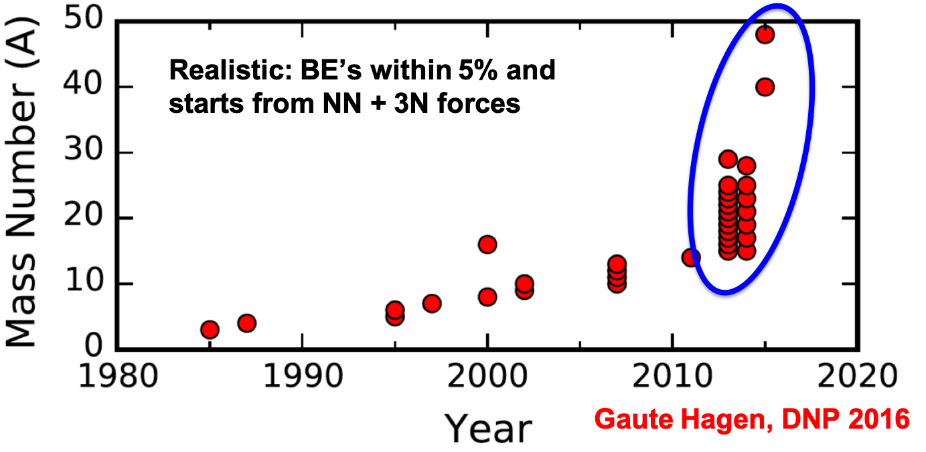
Why low RG resolution?
Methods that rely on soft interactions work well!
Notes:
Many-body methods that utilize soft interactions have seen much progress recently.
Describe nuclear hockey stick figure: This figure shows ab initio calculations that rely on soft interactions with respect to year on the x-axis.
Using just the phenomenological potentials, progress wasn’t too great but recently this has spiked up in the past decade.
This is due to the use of chiral EFTs and RG methods which are extremely useful for many-body methods that are reliant on basis truncations.

Slide 34
Why low RG resolution?
Methods that rely on soft interactions work well!
What SRC physics can we describe using simple approximations?
Try Hartree-Fock (HF) with a local density approximation (LDA) to evaluate nuclear matrix elements
Notes:
So we want to try describing SRC physics using very simple approximations to approximate the nuclear structure component of our calculations.
Start with HF with an LDA to evaluate nuclear matrix elements.

Slide 35
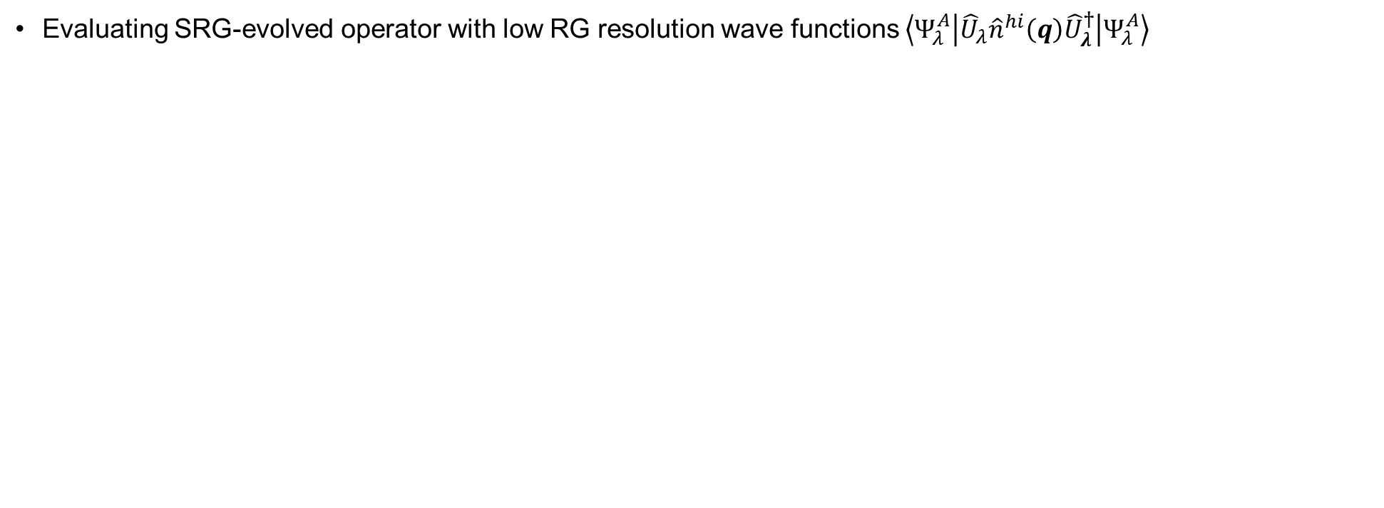
HF and LDA calculation
Evaluating SRG-evolved operator with low RG resolution wave functions $\left\langle Ψ_{λ}^{A} | {\hat{U}}_{λ}{\hat{n}}^{hi}\left(q\right){\hat{U}}_{λ}^{†} | Ψ_{λ}^{A}\right\rangle$
Notes:
In the next few slides, I’ll outline how this calculation works.
We start with the following expression: the evolved operator sandwiched between the nuclear wave function at low RG resolution.

Slide 36
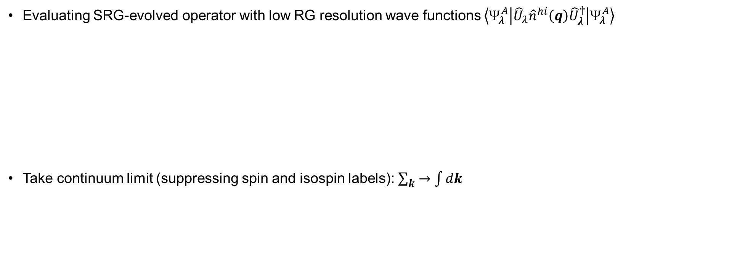
HF and LDA calculation
Evaluating SRG-evolved operator with low RG resolution wave functions $\left\langle Ψ_{λ}^{A} | {\hat{U}}_{λ}{\hat{n}}^{hi}\left(q\right){\hat{U}}_{λ}^{†} | Ψ_{λ}^{A}\right\rangle$
Take continuum limit (suppressing spin and isospin labels): $\sum_{k}{→\int{dk}}$
Notes:
We convert the sums to integrals by taking the continuum limit.
Explain suppression of additional labels.

Slide 37
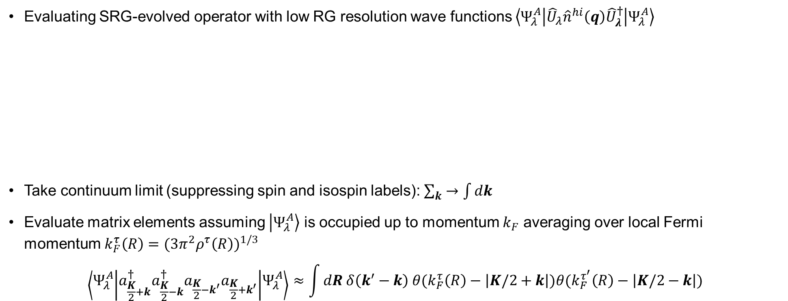
HF and LDA calculation
Evaluating SRG-evolved operator with low RG resolution wave functions $\left\langle Ψ_{λ}^{A} | {\hat{U}}_{λ}{\hat{n}}^{hi}\left(q\right){\hat{U}}_{λ}^{†} | Ψ_{λ}^{A}\right\rangle$
Take continuum limit (suppressing spin and isospin labels): $\sum_{k}{→\int{dk}}$
Evaluate matrix elements assuming $\left|\left.Ψ_{λ}^{A}\right\rangle \right.$ is occupied up to momentum $k_{F}$ averaging over local Fermi momentum $k_{F}^{τ}\left(R\right)={(3π^{2}ρ^{τ}\left(R\right))}^{1/3}$
$$\left\langle Ψ_{λ}^{A} | a_{\frac{K}{2}+k}^{†}a_{\frac{K}{2}−k}^{†}a_{\frac{K}{2}−k^{′}}a_{\frac{K}{2}+k^{′}} | Ψ_{λ}^{A}\right\rangle ≈\int{dR δ\left(k^{′}−k\right) θ(k_{F}^{τ}\left(R\right)−\left|K/2+k\right|)θ(k_{F}^{τ^{′}}\left(R\right)−\left|K/2−k\right|})$$
Notes:
Next evaluate terms like this by assuming \Psi_A is occupied up to some Fermi momentum kF and average over a local Fermi momentum defined by the nucleonic densities \rho.
\tau labels the isospin projection so proton or neutron.
This gives an integration over R, a delta function, and two Heaviside step functions which restrict values of relative and total CM momentum.

Slide 38
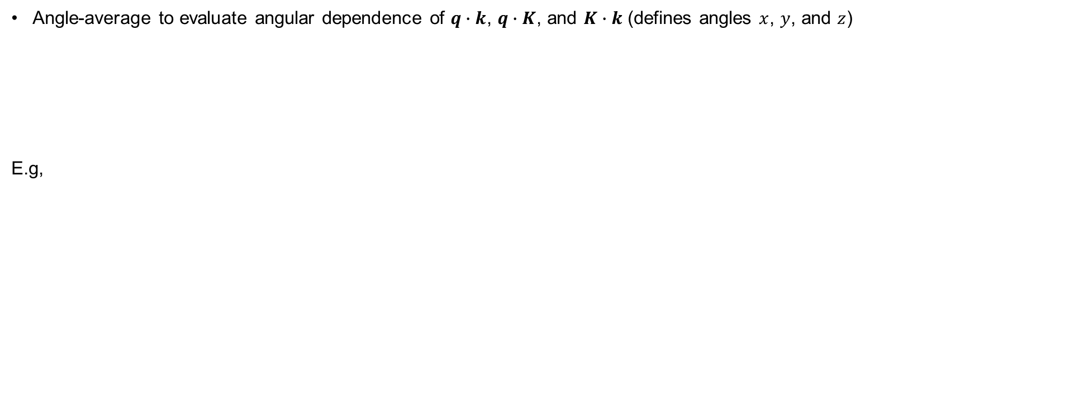
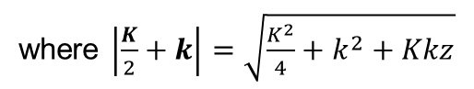
HF and LDA calculation
Angle-average to evaluate angular dependence of $q∙k$, $q∙K$, and $K∙k$ (defines angles $x$, $y$, and $z$)
E.g,
where $\left|\frac{K}{2}+k\right|=\sqrt{\frac{K^{2}}{4}+k^{2}+Kkz}$
Notes:
Next, we can evaluate the angular dependence of the following quantities by angle-averaging.
This involves evaluating expressions like these, which give several cases based on the values of the Fermi momentum.

Slide 39
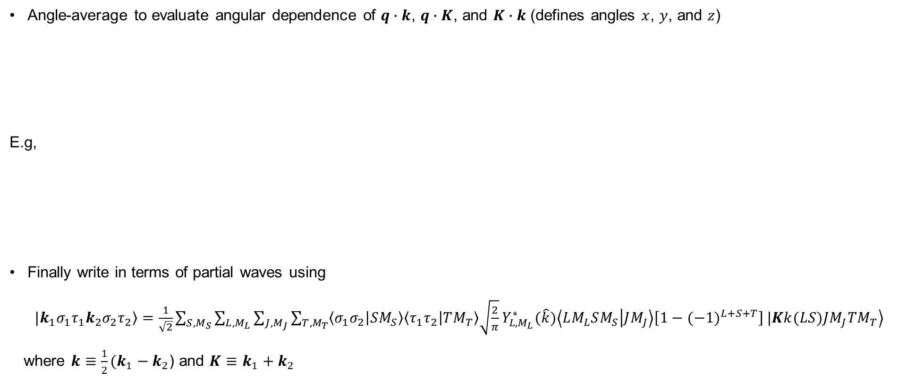
HF and LDA calculation
Angle-average to evaluate angular dependence of $q∙k$, $q∙K$, and $K∙k$ (defines angles $x$, $y$, and $z$)
E.g,
Finally write in terms of partial waves using
$\left.|k_{1}σ_{1}τ_{1}k_{2}σ_{2}τ_{2}\right\rangle$ $=\frac{1}{\sqrt{2}}\sum_{S,M_{S}}{\sum_{L,M_{L}}{\sum_{J,M_{J}}{\sum_{T,M_{T}}{\left\langle σ_{1}σ_{2} | SM_{S}\right\rangle \left\langle τ_{1}τ_{2} | TM_{T}\right\rangle \sqrt{\frac{2}{π}}}Y_{L,M_{L}}^{∗}(\hat{k})\left\langle LM_{L}SM_{S} | JM_{J}\right\rangle \left[1−{(−1)}^{L+S+T}\right]}}}\left.|Kk(LS)JM_{J}TM_{T}\right\rangle$
where $k≡\frac{1}{2}(k_{1}−k_{2}$) and $K≡$ $k_{1}+k_{2}$
where $\left|\frac{K}{2}+k\right|=\sqrt{\frac{K^{2}}{4}+k^{2}+Kkz}$
Notes:
Lastly, we transform the \delta U matrix elements to partial waves using the following relation, where we couple (list), and k is the relative momentum and K the CM momentum.

Slide 40
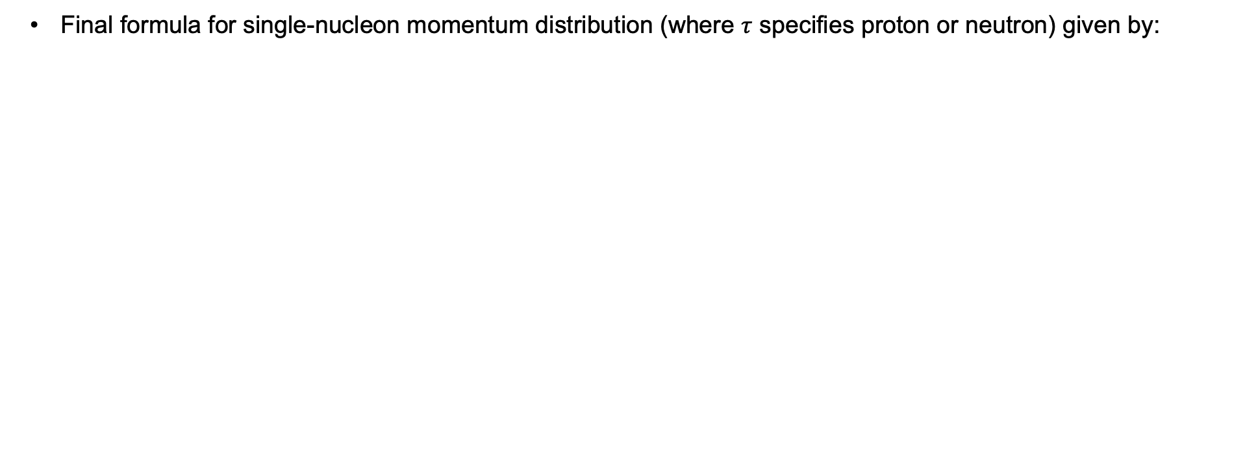
HF and LDA calculation
Final formula for single-nucleon momentum distribution (where $τ$ specifies proton or neutron) given by:
Notes:
This gives the final expression for the single-nucleon momentum distribution.
A few terms given here: point out the two at low-q and the high-q one.
Why is the last one high-q?

Slide 41
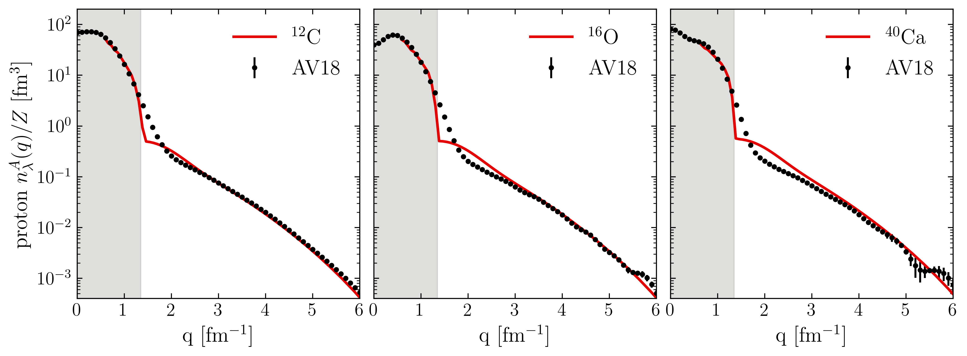
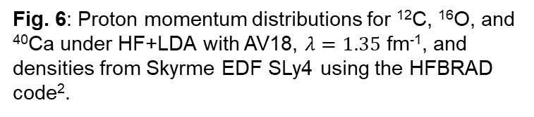
Proton momentum distributions
¹R.B. Wiringa et al., Phys. Rev. C 89, 024305 (2014)
https://www.phy.anl.gov/theory/research/momenta/
²K. Bennaceur et al., Comput. Phys. Commun. 168, 96 (2005)
Low RG resolution calculations reproduce momentum distributions of AV18 VMC calculations¹ (high RG resolution)
Fig. 6: Proton momentum distributions for ¹²C, ¹⁶O, and ⁴⁰Ca under HF+LDA with AV18, $λ=1.35$ fm⁻¹, and densities from Skyrme EDF SLy4 using the HFBRAD code².
Notes:
Compare to AV18 VMC calculations
“We can get a good description of proton momentum distributions using densities from just a Skyrme EDF (SLy4) and 2-body physics shifted into the operator”, emphasize that the high-q tail works well.
Why is the intermediate q region the worst? Operator cut at 2-body and WF is just HF. (IMSRG decoupling example).
Why isn’t low-q showing? Low-q corresponds to large-r in LDA where a local density approximation will not work.

Slide 42
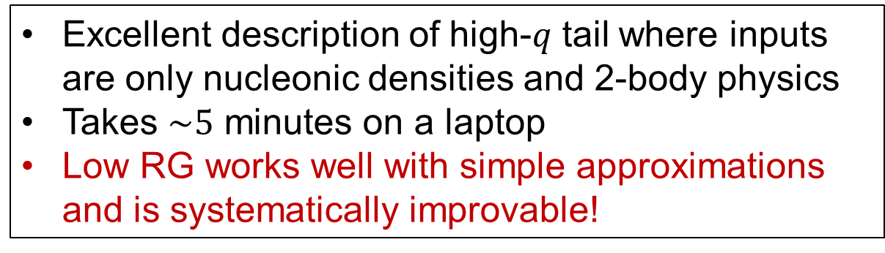
Proton momentum distributions
¹R.B. Wiringa et al., Phys. Rev. C 89, 024305 (2014)
https://www.phy.anl.gov/theory/research/momenta/
²K. Bennaceur et al., Comput. Phys. Commun. 168, 96 (2005)
Low RG resolution calculations reproduce momentum distributions of AV18 VMC calculations¹ (high RG resolution)
Excellent description of high-$q$ tail where inputs are only nucleonic densities and 2-body physics
Takes $\sim 5$ minutes on a laptop
Low RG works well with simple approximations and is systematically improvable!
Fig. 6: Proton momentum distributions for ¹²C, ¹⁶O, and ⁴⁰Ca under HF+LDA with AV18, $λ=1.35$ fm⁻¹, and densities from Skyrme EDF SLy4 using the HFBRAD code².
Notes:
Using only nucleonic densities and 2–body physics we get an excellent description of the high momentum tail, using only roughly 5 minutes on my laptop.
The major takeaway is (read last bullet).

Slide 43
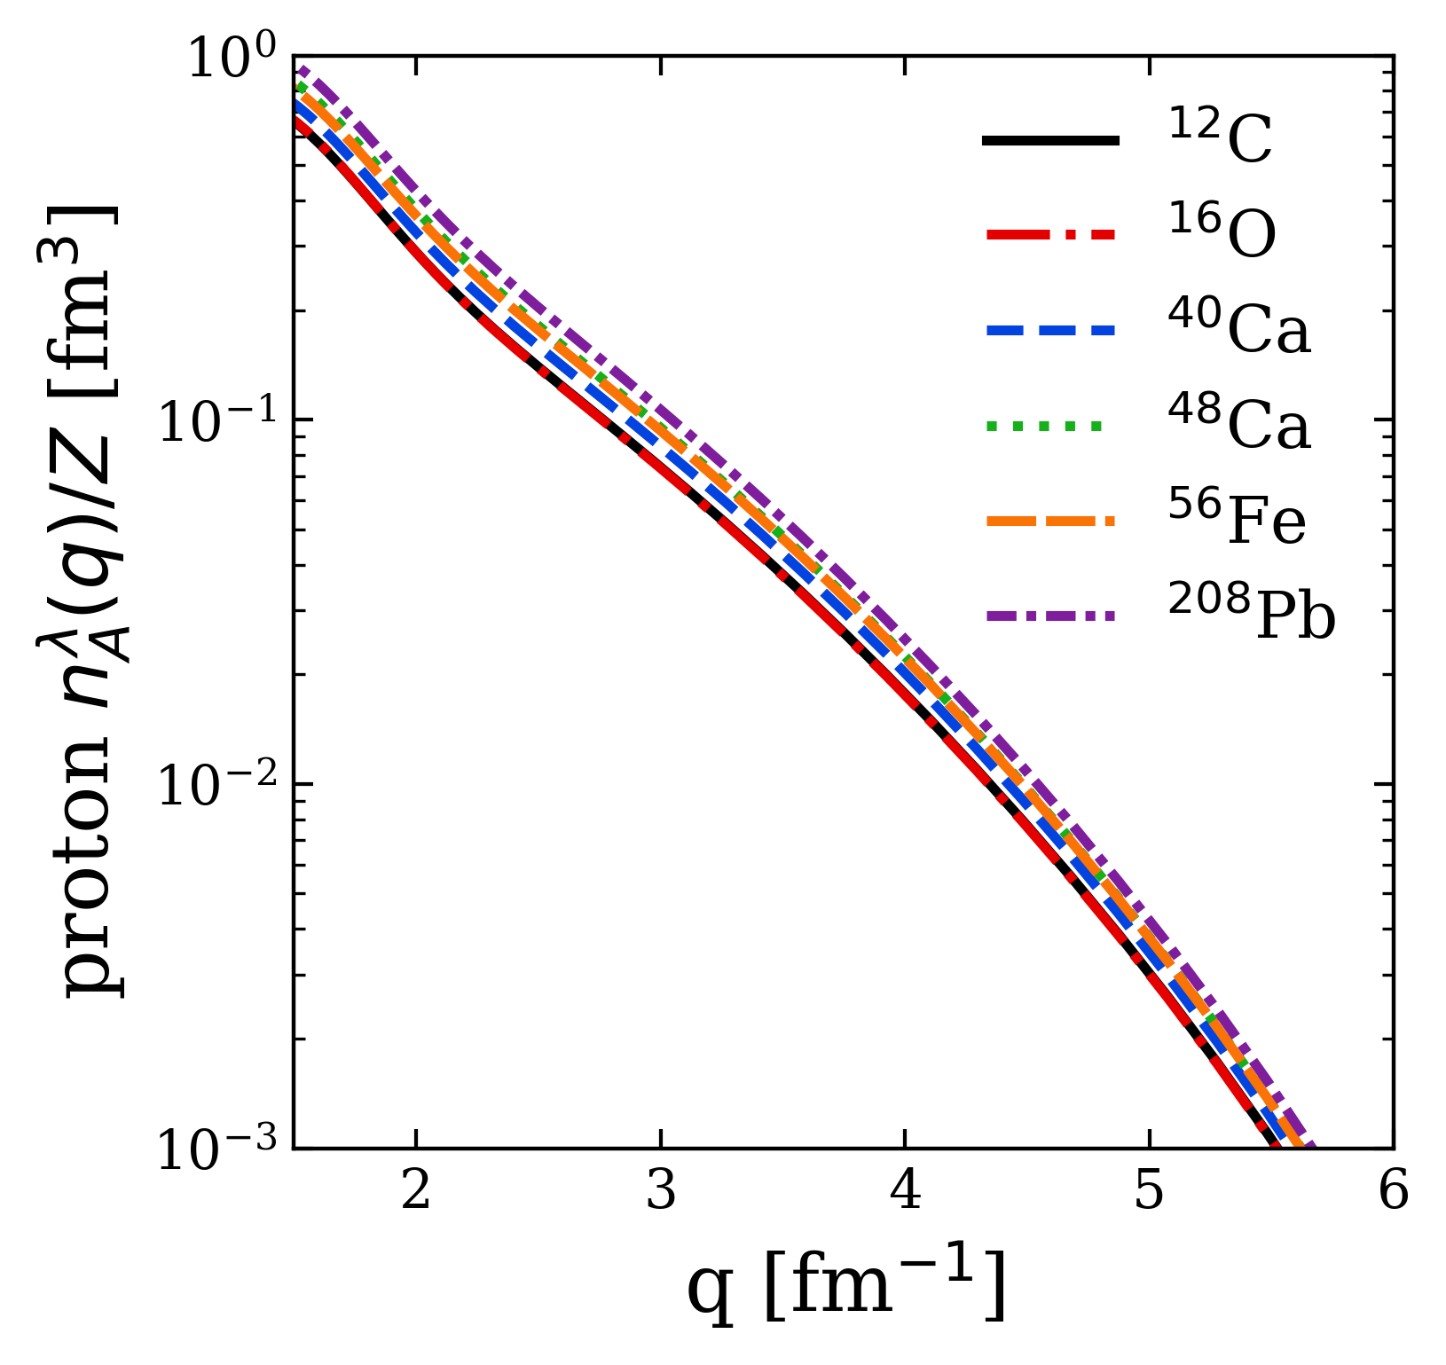


Proton momentum distributions
Universality: High-$q$ dependence from universal function $≈{\left|F_{λ}^{hi}\left(q\right)\right|}^{2}$ fixed by 2-body and insensitive to nucleus
Fig. 7: Proton momentum distributions under HF+LDA with AV18 and $λ=1.35$ fm⁻¹, showing several nuclei.
Notes:
Explain figure.
The high momentum dependence is fixed by 2-body and does not depend on the nucleus.

Slide 44



Proton momentum distributions
Consistent with universal high-$q$ tails from VMC calculations of R. B. Wiringa et al., Phys. Rev. C 89, 024305 (2014)
Fig. 7: Proton momentum distributions under HF+LDA with AV18 and $λ=1.35$ fm⁻¹, showing several nuclei.
Notes:
Universality consistent with AV18 VMC calculations as well which is seen here by comparing the high momentum tails of the various momentum distributions.

Slide 45


SRC scaling factors
SRC scaling factors $a_{2}$ defined by plateau in cross section ratio $\frac{2σ_{A}}{Aσ_{d}}$ at $1.45≤x≤1.9$
Closely related to the ratio of bound-nucleon probability distributions in the limits of vanishing relative distance (infinitely high relative momentum)
Extract $a_{2}$ from momentum distributions
$$a_{2}=\lim_{q→∞}{\frac{P^{A}(q)}{P^{d}(q)}≈}\frac{\int_{Δq^{high}}{dqP^{A}(q)}}{\int_{Δq^{high}}{dqP^{d}(q)}}$$
where $P^{A}\left(q\right)$ is the single-nucleon probability distribution in nucleus A
$$a_{2}$$
Fig. 8: Ratio of per-nucleon electron scattering cross section of nucleus A to that of deuterium, where the red line indicates a constant fit. Figure from B. Schmookler et al. (CLAS), Nature 566, 354 (2019).
Notes:
SRC scaling factors determined by constant plateau in cross section ratios of A/d indicated by this red line for several nuclei.
Second bullet.
Probability distribution is proportional to the momentum distribution.
We can produce SRC scale factors using momentum distributions at high momentum.

Slide 46



SRC scaling factors
¹E. Chabanat et al., Nucl. Phys. A 635, 231 (1998)
²J. Decharge et al., Phys. Rev. C 21, 1568 (1980)
³B. Schmookler et al. (CLAS), Nature 566, 354 (2019)
⁴J. Ryckebusch et al., Phys. Rev. C 100, 054620 (2019)
$$a_{2}=\lim_{q→∞}{\frac{P^{A}(q)}{P^{d}(q)}≈}\frac{\int_{Δq^{high}}{dqP^{A}(q)}}{\int_{Δq^{high}}{dqP^{d}(q)}}$$
High momentum behavior is characterized by 2-body ${\left|F_{λ}^{hi}\left(q\right)\right|}^{2}$ which cancels leaving ratio of mean-field (low-$k$) physics
Good agreement with $a_{2}$ values from experiment³ and LCA calculations⁴ using two different EDFs
Error bars from varying $Δq^{high}$
Fig. 9: $a_{2}$ scale factors using single-nucleon momentum distributions under HF+LDA (SLy4 in red¹, Gogny² in blue) with AV18 and $λ=1.35$ fm⁻¹ compared to experimental values³.
Notes:
Explain figure first: experiment, two calculations for different EDFs for several nuclei.
Read second bullet.
Gives good agreement with experiment and LCA calculations from this reference (point) using two different EDFs.
Note, the error bars are determined from varying the high momentum interval for the integration limits.

Slide 47
SRC phenomenology
np includes ¹S₀ and ³S₁-³D₁
Scalar limit
At high RG resolution, the tensor force and the repulsive core of the NN interaction kicks nucleon pairs into SRCs
np dominates because the tensor force requires spin triplet pairs, whereas pp are spin singlets
Do we describe this physics at low RG resolution?
Fig. 10: (a) Ratio of two-nucleon to single-nucleon electron-scattering cross sections for carbon as a function of missing momentum. (b) Fraction of np to p and pp to p pairs versus the relative momentum. Figure from CLAS collaboration publication¹.
¹I. Korover et al. (CLAS), arXiv:2004.07304 (2014)
Notes:
Don't bother describing (a) - just say these are cross section ratios on the left, on the right are the pair fraction of proton-neutron and proton-proton.
Focus on the pair fraction on the right.
The pp verse pn pair fractions w.r.t. relative momentum.
The idea is that (read bullets pointing to the figure).
At higher momentum, the fraction approaches the scalar limit.
Last bullet.

Slide 48



SRC phenomenology
np dominance
At low RG resolution, SRCs are suppressed in the wave function and shifted into the operator
$${\hat{n}}^{lo}\left(q\right)={\hat{U}}_{λ}a_{q}^{†}a_{q}{\hat{U}}_{λ}^{†}=U_{λ}(k,q)U_{λ}^{†}(q,k^{′})$$
Take ratio of ³S₁ and ¹S₀ SRG transformations fixing low-momenta to $k_{0}=0.1$ fm⁻¹
This physics is established in the 2-body system – can apply to any nucleus!
Scalar limit
Fig. 11: ³S₁ to ¹S₀ ratio of SRG-evolved momentum projection operators $a_{q}^{†}a_{q}$ where $λ=1.35$ fm⁻¹.
Notes:
Read first bullet explaining equation.
Read second bullet.
Explain figure: y-axis, red/blue, x-axis.
Reproduces np dominance at 400 MeV and scalar limit.
Read last bullet.

Slide 49


SRC phenomenology
Low RG resolution picture reproduces the characteristics of cross section ratios using simple approximations
np dominance
Scalar limit
Fig. 12: pp/pn ratio of pair momentum distributions under HF+LDA with AV18 and $λ=1.35$ fm⁻¹.
Notes:
We can do a similar analysis using ratios of the pair momentum distribution where we fix the CM momentum Q=0.
Here is a plot showing this ratio for several nuclei.
Point to np dominance and scalar limit.
Takeaway point.

Slide 50

SRC phenomenology
Low RG resolution picture reproduces the characteristics of cross section ratios using simple approximations
Weak nucleus dependence from factorization
Ratio$≈\frac{{\left|F_{pp}^{hi}(q)\right|}^{2}}{{\left|F_{np}^{hi}(q)\right|}^{2}}×\frac{\left\langle Ψ_{λ}^{A} | \sum_{k,k′}^{λ}{a_{\frac{Q}{2}+k}^{†}a_{\frac{Q}{2}−k}^{†}a_{\frac{Q}{2}−k^{′}}a_{\frac{Q}{2}+k^{′}}} | Ψ_{λ}^{A}\right\rangle }{\left\langle Ψ_{λ}^{A} | \sum_{k,k′}^{λ}{a_{\frac{Q}{2}+k}^{†}a_{\frac{Q}{2}−k}^{†}a_{\frac{Q}{2}−k^{′}}a_{\frac{Q}{2}+k^{′}}} | Ψ_{λ}^{A}\right\rangle }$
np dominance
Scalar limit
Fig. 12: pp/pn ratio of pair momentum distributions under HF+LDA with AV18 and $λ=1.35$ fm⁻¹.
Notes:
Explain weak nucleus dependence.

Slide 51



SRC phenomenology
Ratio $\sim 1$ independent of N/Z in np dominant region
Ratio $<1$ for nuclei where N $>$ Z and outside np dominant region
np dominance
Fig. 13: (pp+pn)/(nn+np) ratio of pair momentum distributions under HF+LDA with AV18 and $λ=1.35$ fm⁻¹.
Notes:
We can also look at isospin dependence: by taking ratios of the PMD, we see the pn-dominant region is independent of N/Z while the scalar limits depends on N/Z.

Slide 52


Other exclusive knockout reactions
Apply similar low RG analysis to exclusive knockout reactions in ($e$,$e^{′}p$) scattering
Nucleon knocked out from specific shell model state of target nucleus $A$
In progress
Fig. 14: Momentum profiles as function of missing momentum for valence holes in nuclei. Data (black points) from NIKHEF experiments. Figure from T. Aumann et al., Prog. Part. Nucl. Phys. 118, 103847 (2021).
Notes:
Next we consider applying the same sort of analysis but for exclusive knockout reactions in (e,e’p) scattering.
In this reaction, a nucleon is knocked out from a specific state of the target nucleus.
Mention much lower momentum scale than what was considered prior.

Slide 53

Other exclusive knockout reactions
Apply similar low RG analysis to exclusive knockout reactions in ($e$,$e^{′}p$) scattering
Nucleon knocked out from specific shell model state of target nucleus $A$
Momentum dependence of ($e$,$e^{′}p$) exclusive cross section is dominated by the single-particle (sp) wave function
Spectroscopic factor needed to reduce the theoretical cross section to match experiment
In progress
Fig. 14: Momentum profiles as function of missing momentum for valence holes in nuclei. Data (black points) from NIKHEF experiments. Figure from T. Aumann et al., Prog. Part. Nucl. Phys. 118, 103847 (2021).
Notes:
Here is a figure showing the reduced cross section for several nuclei comparing to data from NIKHEF experiments.
The momentum dependence is well described by the sp momentum distribution but a spectroscopic factor is necessary to agree with experiment.

Slide 54


Other exclusive knockout reactions
Systematic trend for discrepancy in exp/theory as a function of $ΔS$
RG analysis can help understand the cause of $R=\frac{σ_{exp}}{σ_{theory}}<1$
Mismatch of scale between one-body (high RG) operator and shell model structure (low RG) gives $σ_{theory}>σ_{exp}$
Fig. 15: $R$ as a function of $∆S$. Red (blue) points correspond to neutron-removal (proton-removal) cases. Solid black squares correspond to electron-induced proton knockout data. Figure from J. A. Tostevin and A. Gade, Phys. Rev. C 90, 057602 (2014).
Notes:
Furthermore, the factor difference between theory and experiment varies with \Delta S, the difference in nucleon separation energy, shown here in this plot.
Explain picture: This plot shows the ratio of experimental over theory cross sections as a function of \Delta S for various knock-out reactions: black, red, blue.
We see the ratio decreases as \Delta S increases.
The origin of this is not understood but could be stemming from the (third bullet) in which case the (second bullet).

Slide 55


Other exclusive knockout reactions
Systematic trend for discrepancy in exp/theory as a function of $ΔS$
RG analysis can help understand the cause of $R=\frac{σ_{exp}}{σ_{theory}}<1$
Mismatch of scale between one-body (high RG) operator and shell model structure (low RG) gives $σ_{theory}>σ_{exp}$
Currently working on SRG-evolving spectroscopic factors for $(e,e^{′}p)$ reactions
Note, spectroscopic factors are scale/scheme dependent
In progress
Fig. 15: $R$ as a function of $∆S$. Red (blue) points correspond to neutron-removal (proton-removal) cases. Solid black squares correspond to electron-induced proton knockout data. Figure from J. A. Tostevin and A. Gade, Phys. Rev. C 90, 057602 (2014).
Notes:
To better understand this, we are currently working on SRG-evolving spectroscopic factors for (e,e’p) reactions.
Note, SFs are scale/scheme dependent so using the RG is the correct way for analyzing them.

Slide 56


Spectroscopic factors
Spectroscopic factor for sp state $α$ defined in terms of removal amplitude
$$S=\int{dp{\left|\left\langle Ψ_{α}^{A−1} | a_{p} | Ψ_{0}^{A}\right\rangle \right|}^{2}}$$
Notes:
So the spectroscopic factor for a particular sp state \alpha is defined in terms of the removal amplitude where this annihilation operator is sandwiched between the an A-body nuclear ground state and an A-1 residue in the state \alpha.

Slide 57


Spectroscopic factors
Spectroscopic factor for sp state $α$ defined in terms of removal amplitude
$$S=\int{dp{\left|\left\langle Ψ_{α}^{A−1} | a_{p} | Ψ_{0}^{A}\right\rangle \right|}^{2}}$$
sp strength is reduced relative to the independent-particle model (IPM) by correlations: Long-range correlations (LRC) and SRC
Notes:
Read second bullet.
Explain cartoon schematic.
Explain figure on the right: Spectroscopic factors for several nuclei relative to the IPM: all about 65% of the IPM.

Slide 58
Spectroscopic factors
Spectroscopic factor for sp state $α$ defined in terms of removal amplitude
$$S=\int{dp{\left|\left\langle Ψ_{α}^{A−1} | a_{p} | Ψ_{0}^{A}\right\rangle \right|}^{2}}$$
sp strength is reduced relative to the independent-particle model (IPM) by correlations: Long-range correlations (LRC) and SRC
Idea: SRG evolve and analyze using simple approximations (i.e., IPM)
Notes:
Read last point.

Slide 59
Summary
At low renormalization group (RG) resolution, simple approximations to SRC physics work and are systematically improvable
Results suggest that we can analyze high-energy nuclear reactions using low RG resolution structure (e.g., shell model) and consistently evolved operators
Matching resolution scale between structure and reactions is crucial!

Slide 60

Summary
At low renormalization group (RG) resolution, simple approximations to SRC physics work and are systematically improvable
Results suggest that we can analyze high-energy nuclear reactions using low RG resolution structure (e.g., shell model) and consistently evolved operators
Matching resolution scale between structure and reactions is crucial!
Outlook:
Extend to $(e,e^{′}p)$ and other knockout reactions and test scale/scheme dependence of extracted properties
Benchmark calculations with other ab initio methods
Investigate impact of various corrections: 3-body terms, final state interactions, etc.
Implement uncertainty quantification in low RG resolution calculations

Slide 61
Extras
Fig. 16: Cartoon snapshots of a nucleus at (left) low-RG and (right) high-RG resolutions. The back-to-back nucleons at high-RG resolution are an SRC pair with small center-of-mass momentum.

Slide 62
Extras
Kinematics chosen such that two-nucleon knock-out dominates
Break up the pair, detect both nucleons, and reconstruct initial state
Kinematics minimize final state interactions and meson exchange currents

Slide 63

Extras
Universality: Low-energy physics of different interactions becomes the same at low RG resolution
Fig. 17: Initial and SRG-evolved deuteron wave functions in coordinate space for several chiral interactions.
Fig. 18: SRG evolution for several chiral interactions in the ³S₁-³S₁ channel.

Slide 64


Extras
Consider an operator dominated by high momentum $q$ where $k<λ$ and $q≫λ$
Expand the eigenstates $ψ_{α}^{∞}$ of the initial NN Hamiltonian in terms of the SRG-evolved states $ψ_{α}^{λ}$
$$ψ_{α}^{∞}\left(q\right)≈γ^{λ}\left(q\right)\int_{0}^{λ}{d\tilde{p}Z\left(λ\right)ψ_{α}^{λ}\left(p\right)+η^{λ}\left(q\right)\int_{0}^{λ}{d\tilde{p}p^{2}Z\left(λ\right)ψ_{α}^{λ}\left(p\right)}}+⋯$$
Substitute leading-order term of operator product expansion (OPE) in spectral representation of SRG transformation
$$U_{λ}\left(k,q\right)=\sum_{α}^{∞}{\left\langle k | ψ_{α}^{λ}\right\rangle \left\langle ψ_{α}^{∞} | q\right\rangle }$$
$$≈[\sum_{α}^{\left|E_{α}\right|≪\left|E_{QHQ}\right|}{\left\langle k | ψ_{α}^{λ}\right\rangle }\int_{0}^{λ}{d\tilde{p}Z\left(λ\right)ψ_{α}^{λ†}\left(p\right)]}γ^{λ}\left(q\right)$$
$$≡K_{λ}(k)Q_{λ}(q)$$
Fig. 19: Ratio of $δUδU^{†}(k,q)$ for fixed $k$ and $λ$.
Notes:
Short-distance details decouple from long-distance dynamics.
Initial operator is dominated by high momenta.
Focus on k<\lambda and q>>\lambda.
\psi_\alpha^\infinity(q) \approx \gamma^\lambda(q) \int_0^\lambda dp^\tilde Z(\lambda) \psi_\alpha^\lambda(p) + … (analog of Lepage’s operator product expansion)

